Slide 1

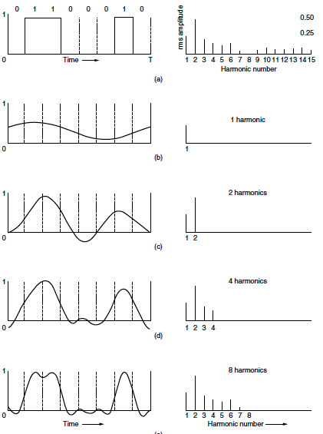
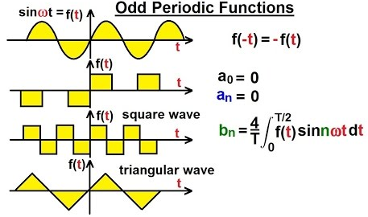
Fourier Series

Slide 2
Book: Advanced Modern Engineering Mathematics (4th Edition) by Glyn James
Chapter: 7
Sections: 7.1,7.2
Book: Signals and Systems (2nd Edition) by Alan V. Oppenheim, Alan S. Willsky, and S. Hamid Nawab
Chapter: 3
Sections: 3.3
Book: Advanced Engineering Mathematics (9th Edition) by Ervin Kreyszig
Chapter: 11
Sections: 11.1

Slide 3
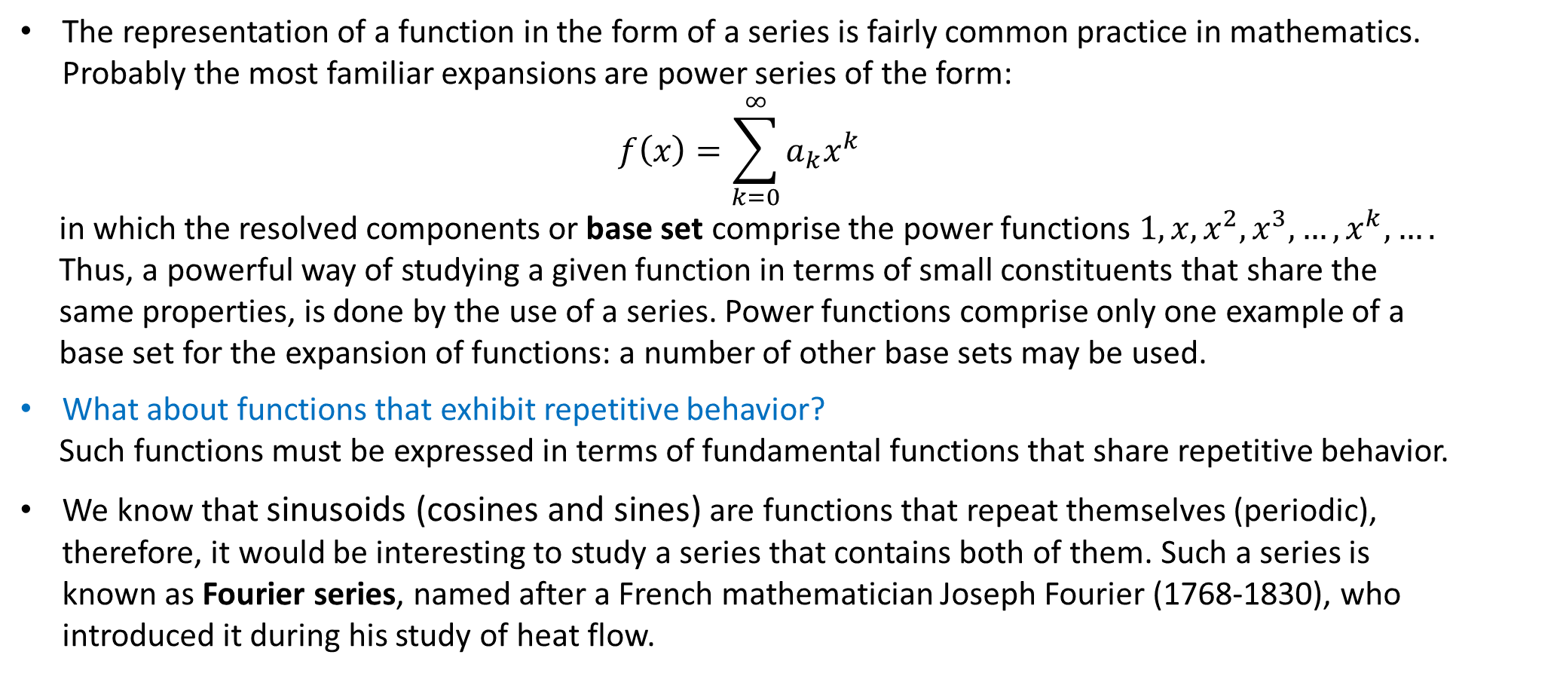
Introduction:
The representation of a function in the form of a series is fairly common practice in mathematics. Probably the most familiar expansions are power series of the form:
$$f\left(x\right)=\sum_{k=0}^{∞}{a_{k}x^{k}}$$
in which the resolved components or base set comprise the power functions $1,x,x^{2},x^{3},…,x^{k},….$
Thus, a powerful way of studying a given function in terms of small constituents that share the
same properties, is done by the use of a series. Power functions comprise only one example of a
base set for the expansion of functions: a number of other base sets may be used.
What about functions that exhibit repetitive behavior?
Such functions must be expressed in terms of fundamental functions that share repetitive behavior.
We know that sinusoids (cosines and sines) are functions that repeat themselves (periodic), therefore, it would be interesting to study a series that contains both of them. Such a series is known as Fourier series, named after a French mathematician Joseph Fourier (1768-1830), who introduced it during his study of heat flow.

Slide 4
How to Represent Signals?
In Electrical Engineering, there are several instances where one deals with signals(waveforms) and manipulations of signals. The manipulation may be any operation such as addition, multiplication, differentiation, integration etc. This manipulation maybe a result of a tangible electrical circuit (RC, LC, RLC) or simply an abstract system. Hence, a strong analytical method is needed to examine the results and side-effects.
The number of possible waveforms are obviously infinite. Trying to change the analytical approach every time we encounter a new signal is extremely impractical. Hence, what we need is a representative signal i.e., a single signal which can capture the essence of almost any signal. This is essentially what the Fourier series offers. Since, the sinusoidal signal are periodic, therefore, it says that any signal can be decomposed into sum of sinusoids. Now the problem of analyzing signals reduces to the problem of analyzing sinusoids. This allows us to view signals in the “Frequency domain.”
The concept is quite useful in digital signal processing as well where the Fourier series tells us how each frequency component influences the signal characteristics and which components we need to modify to convert the signal to our desired form. Additionally, it presents a finite way to represent signals. Consider a simple scenario in which you need to approximately represent a waveform as a finite series of samples. We can simply use the required number of Fourier coefficients(depending upon the approximation we need) since the resulting signal can easily be reconstructed from them.

Slide 5
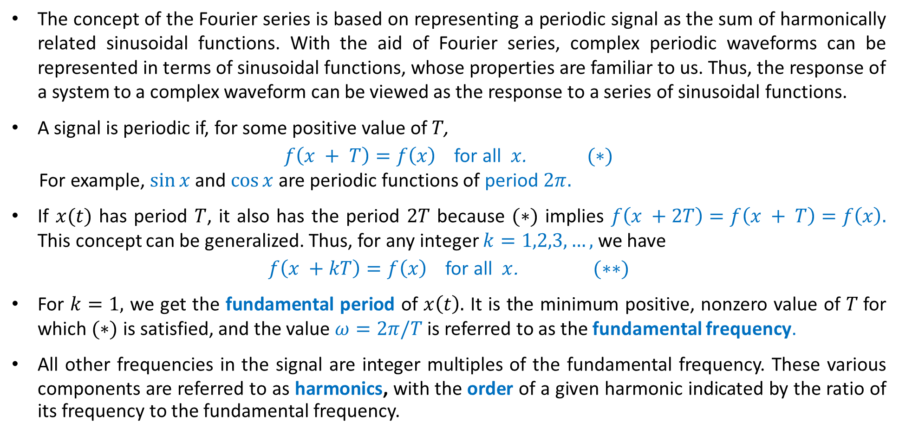
Background Knowledge:
The concept of the Fourier series is based on representing a periodic signal as the sum of harmonically related sinusoidal functions. With the aid of Fourier series, complex periodic waveforms can be represented in terms of sinusoidal functions, whose properties are familiar to us. Thus, the response of a system to a complex waveform can be viewed as the response to a series of sinusoidal functions.
A signal is periodic if, for some positive value of $T$,
$f\left(x + T\right)=f\left(x\right)$for all $x$. $(∗)$
For example, $\sin{x}$ and $\cos{x}$ are periodic functions of period $2π.$
If $x(t)$ has period $T$, it also has the period $2T$ because $(∗)$ implies $f\left(x +2T\right)=f\left(x + T\right)=f\left(x\right).$ This concept can be generalized. Thus, for any integer $k=1,2,3,…,$we have
$f\left(x +kT\right)=f\left(x\right)$for all $x$. $(∗∗)$
For $k=1,$ we get the fundamental period of $x\left(t\right).$ It is the minimum positive, nonzero value of $T$for which $(∗)$ is satisfied, and the value $ω=2π/T$is referred to as the fundamental frequency.
All other frequencies in the signal are integer multiples of the fundamental frequency. These various components are referred to as harmonics, with the order of a given harmonic indicated by the ratio of its frequency to the fundamental frequency.

Slide 6
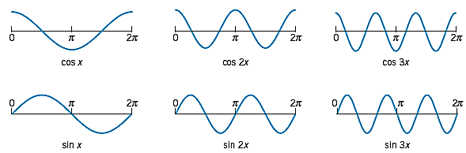

Fundamental Modes
Let us consider various functions $f(x)$ of period $2π$:
$$1, \cos{x}, \cos{2x},…, \cos{kx},…,\sin{x},\sin{2x},…,\sin{kx},…$$
All of these functions have the period $2π.$ They form the so-called trigonometric system.
Cosine and sine functions having the period $2π$ (the first few members of the trigonometric system, except for the constant 1.

Slide 10
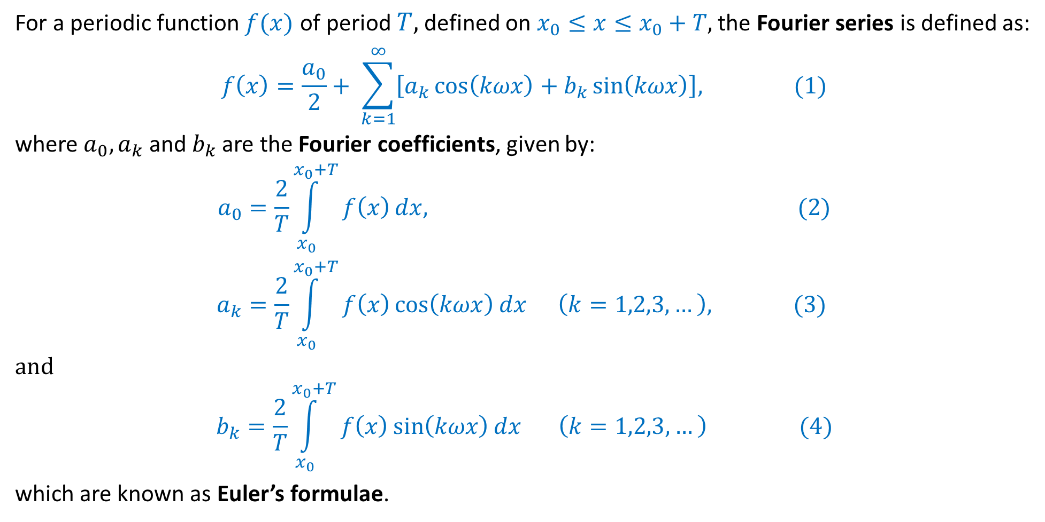
Fourier Series
For a periodic function $f(x)$ of period $T,$ defined on $x_{0}≤x≤x_{0}+T,$ the Fourier series is defined as:
$$f\left(x\right)=\frac{a_{0}}{2}+ \sum_{k=1}^{∞}{\left[a_{k}\cos\left(kωx\right)+b_{k}\sin\left(kωx\right)\right],} (1)$$
where $a_{0},a_{k}$ and $b_{k}$ are the Fourier coefficients, given by:
$$a_{0}=\frac{2}{T}\int_{x_{0}}^{x_{0}+T}{f\left(x\right)}dx, (2)$$
$$a_{k}=\frac{2}{T}\int_{x_{0}}^{x_{0}+T}{f\left(x\right)\cos\left(kωx\right)dx} \left(k=1,2,3,…\right), (3)$$
and
$$b_{k}=\frac{2}{T}\int_{x_{0}}^{x_{0}+T}{f\left(x\right)\sin\left(kωx\right)dx} \left(k=1,2,3,…\right) (4)$$
which are known as Euler’s formulae.

Slide 11
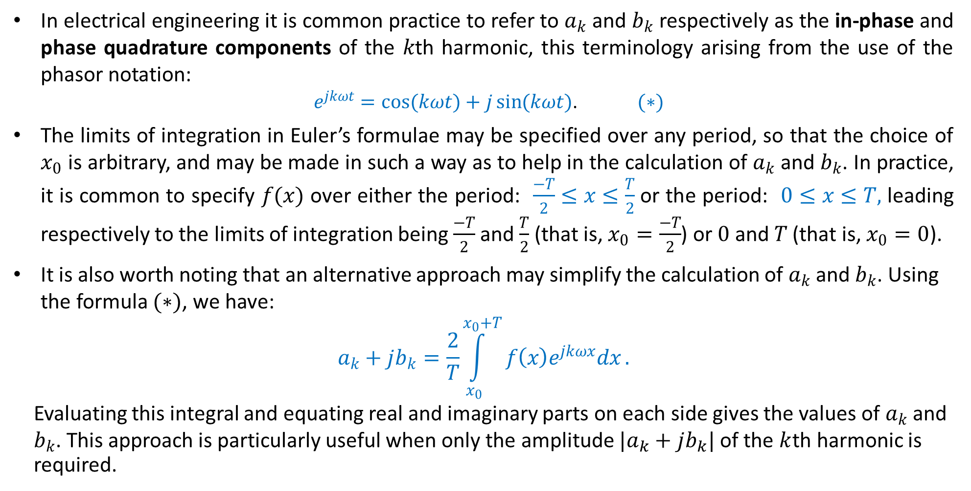
Fourier Series: Important facts
In electrical engineering it is common practice to refer to $a_{k}$ and $b_{k}$ respectively as the in-phase and phase quadrature components of the $k$th harmonic, this terminology arising from the use of the phasor notation:
$e^{jkωt}=\cos{(kωt)}+j\sin{(kωt)}$. $(∗)$
The limits of integration in Euler’s formulae may be specified over any period, so that the choice of $x_{0}$ is arbitrary, and may be made in such a way as to help in the calculation of $a_{k}$ and $b_{k}$. In practice, it is common to specify $f(x)$ over either the period: $\frac{−T}{2}≤x≤\frac{T}{2}$or the period: $0≤x≤T,$ leading respectively to the limits of integration being $\frac{−T}{2}$ and $\frac{T}{2}$ (that is, $x_{0}=\frac{−T}{2}$) or $0$ and $T$ (that is, $x_{0}=0$).
It is also worth noting that an alternative approach may simplify the calculation of $a_{k}$ and $b_{k}$. Using the formula $(∗)$, we have:
$$a_{k}+jb_{k}=\frac{2}{T}\int_{x_{0}}^{x_{0}+T}{f\left(x\right)e^{jkωx}dx}.$$
Evaluating this integral and equating real and imaginary parts on each side gives the values of $a_{k}$ and
$b_{k}$. This approach is particularly useful when only the amplitude $|a_{k}+jb_{k}|$of the $k$th harmonic is
required.

Slide 12
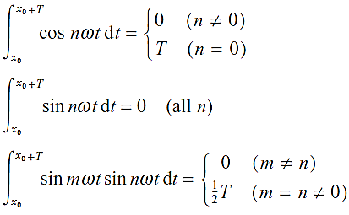
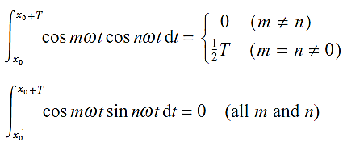

Fourier Series: Important facts
There are few formulae that we need as they help in simplifying Fourier coefficients: $a_{0}, a_{k}$ and $b_{k}$.
The above results constitute the orthogonality relations for sine and cosine functions, and show that the set of functions
$$\{1, \cos{ωx}, \cos{2ωx},…, \cos{kωx},\sin{ωx},\sin{2ωx},…,\sin{kωx}\}$$
is an orthogonal set of functions on the interval $x_{0}≤x≤x_{0}+T$.

Slide 13
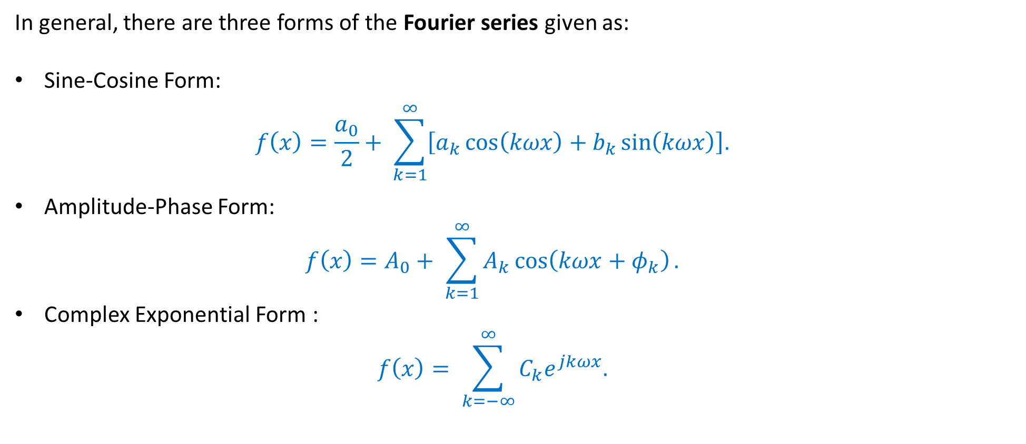
Alternative forms of Fourier Series
In general, there are three forms of the Fourier series given as:
Sine-Cosine Form:
$$f\left(x\right)=\frac{a_{0}}{2}+ \sum_{k=1}^{∞}{\left[a_{k}\cos\left(kωx\right)+b_{k}\sin\left(kωx\right)\right].}$$
Amplitude-Phase Form:
$$f\left(x\right)=A_{0}+ \sum_{k=1}^{∞}{A_{k}\cos\left(kωx+φ_{k}\right).}$$
Complex Exponential Form :
$$f\left(x\right)= \sum_{k=−∞}^{∞}{C_{k}e^{jkωx}.}$$

Slide 14
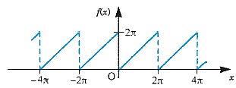
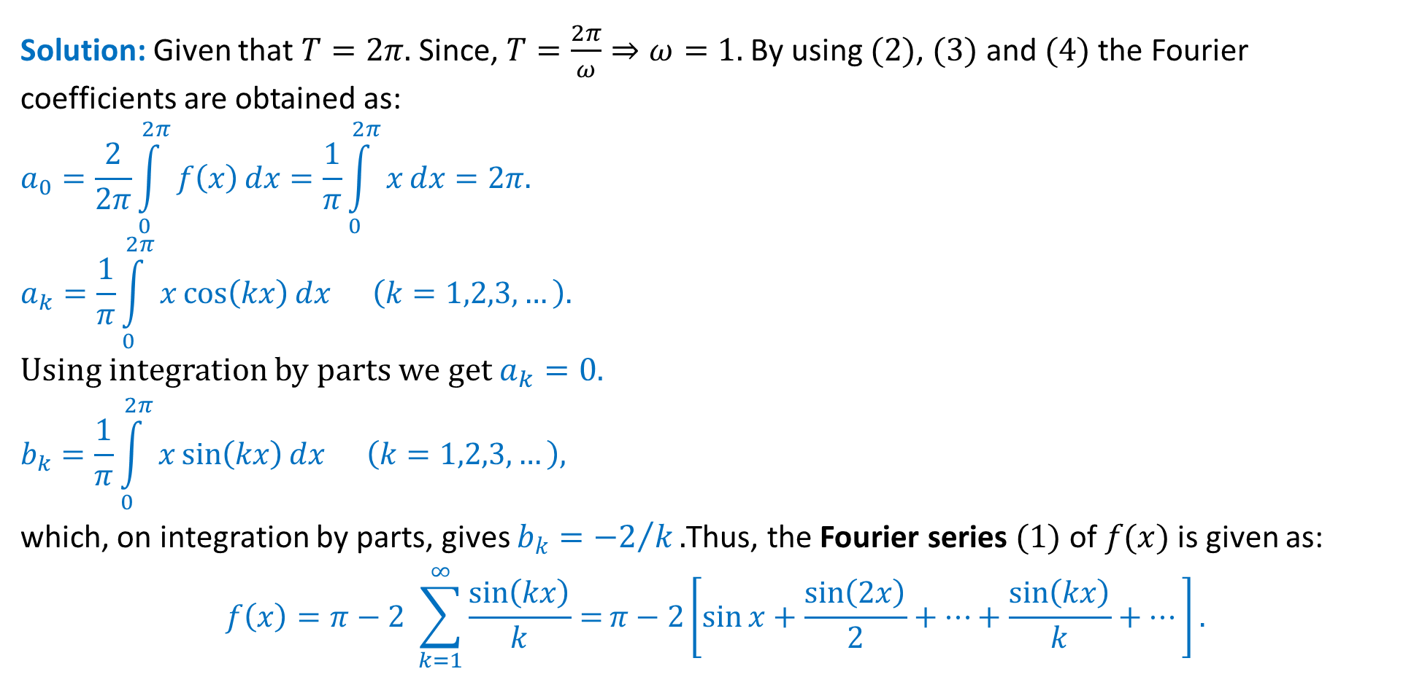
Example: Obtain the Fourier series expansion of the periodic function $f\left(x\right)=x; (0≤x≤2π)$ of period $2π$ i.e., $f\left(x\right)=f\left(x+2π\right).$
Solution: Given that $T=2π.$ Since, $T=\frac{2π}{ω}⇒ω=1.$ By using $(2)$, $(3)$ and $(4)$ the Fourier coefficients are obtained as:
$$a_{0}=\frac{2}{2π}\int_{0}^{2π}{f\left(x\right)}dx=\frac{1}{π}\int_{0}^{2π}{x}dx=2π.$$
$$a_{k}=\frac{1}{π}\int_{0}^{2π}{x\cos\left(kx\right)dx} \left(k=1,2,3,…\right).$$
Using integration by parts we get $a_{k}=0.$
$$b_{k}=\frac{1}{π}\int_{0}^{2π}{x\sin\left(kx\right)dx} \left(k=1,2,3,…\right),$$
which, on integration by parts, gives $b_{k}={−2}/k.$Thus, the Fourier series $(1)$ of $f(x)$ is given as:
$$f\left(x\right)=π−2 \sum_{k=1}^{∞}{\frac{\sin\left(kx\right)}{k}=}π−2\left[\sin{x}+\frac{\sin\left(2x\right)}{2}+…+\frac{\sin\left(kx\right)}{k}+…\right].$$
Sawtooth wave

Slide 16
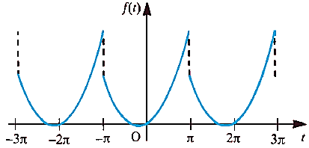
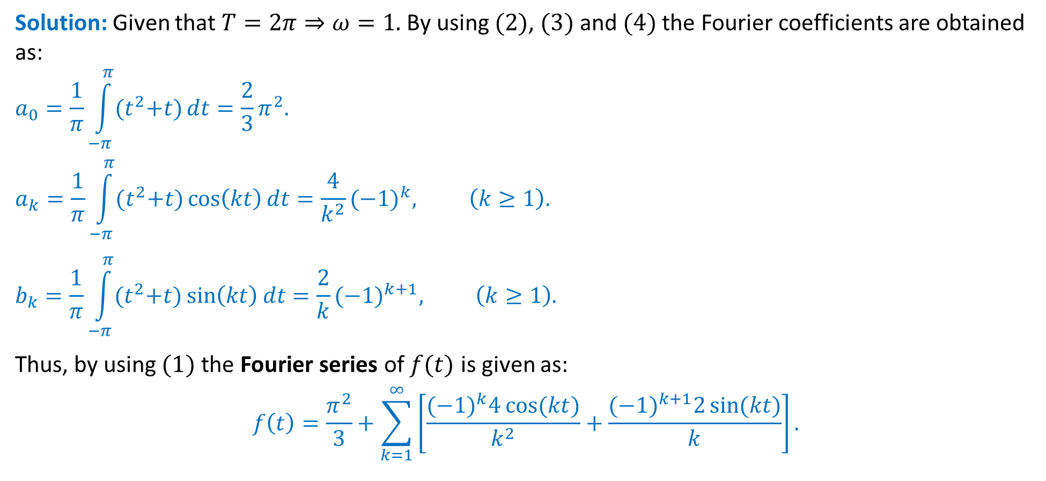
Example: A periodic function $f(t)$ with period $2π$ is defined by $f\left(t\right)=t^{2}+t (−π≤t≤π).$ Sketch a graph of the function f (t) for values of t from t = −3π to t = 3π and obtain a Fourier series expansion of the function.
Solution: Given that $T=2π⇒ω=1.$ By using $(2)$, $(3)$ and $(4)$ the Fourier coefficients are obtained as:
$$a_{0}=\frac{1}{π}\int_{−π}^{π}{{(t}^{2}+t)}dt=\frac{2}{3}π^{2}.$$
$$a_{k}=\frac{1}{π}\int_{−π}^{π}{{(t}^{2}+t)}\cos\left(kt\right)dt=\frac{4}{k^{2}}{(−1)}^{k}, \left(k≥1\right).$$
$$b_{k}=\frac{1}{π}\int_{−π}^{π}{{(t}^{2}+t)}\sin\left(kt\right)dt=\frac{2}{k}{(−1)}^{k+1}, \left(k≥1\right).$$
Thus, by using $(1)$ the Fourier series of $f(t)$ is given as:
$$f\left(t\right)=\frac{π^{2}}{3}+\sum_{k=1}^{∞}{\left[\frac{{(−1)}^{k}4\cos{(kt)}}{k^{2}}+\frac{{(−1)}^{k+1}2\sin{(kt)}}{k}\right]}.$$

Slide 17
Alternative Method: By using equation $(∗∗)$
$$a_{k}+ib_{k}=\frac{1}{π}\int_{−π}^{π}{{(t}^{2}+t)}e^{ikt}dt={(−1)}^{k}\left[\frac{4}{k^{2}}−i\frac{2}{k}\right].$$
Equating real and imaginary parts, we get
$$a_{k}=\frac{4}{k^{2}}{(−1)}^{k}, and b_{k}=\frac{2}{k}{(−1)}^{k+1}, \left(k≥1\right).$$
Thus, by using $(1)$ the Fourier series of $f(t)$ is given as:
$$f\left(t\right)=\frac{π^{2}}{3}+\sum_{k=1}^{∞}{\left[\frac{{(−1)}^{k}4\cos{(kt)}}{k^{2}}+\frac{{(−1)}^{k+1}2\sin{(kt)}}{k}\right]}.$$
Note: $a_{0}$ will be computed as before, i.e., by using $(2)$.

Slide 18
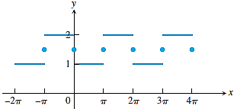
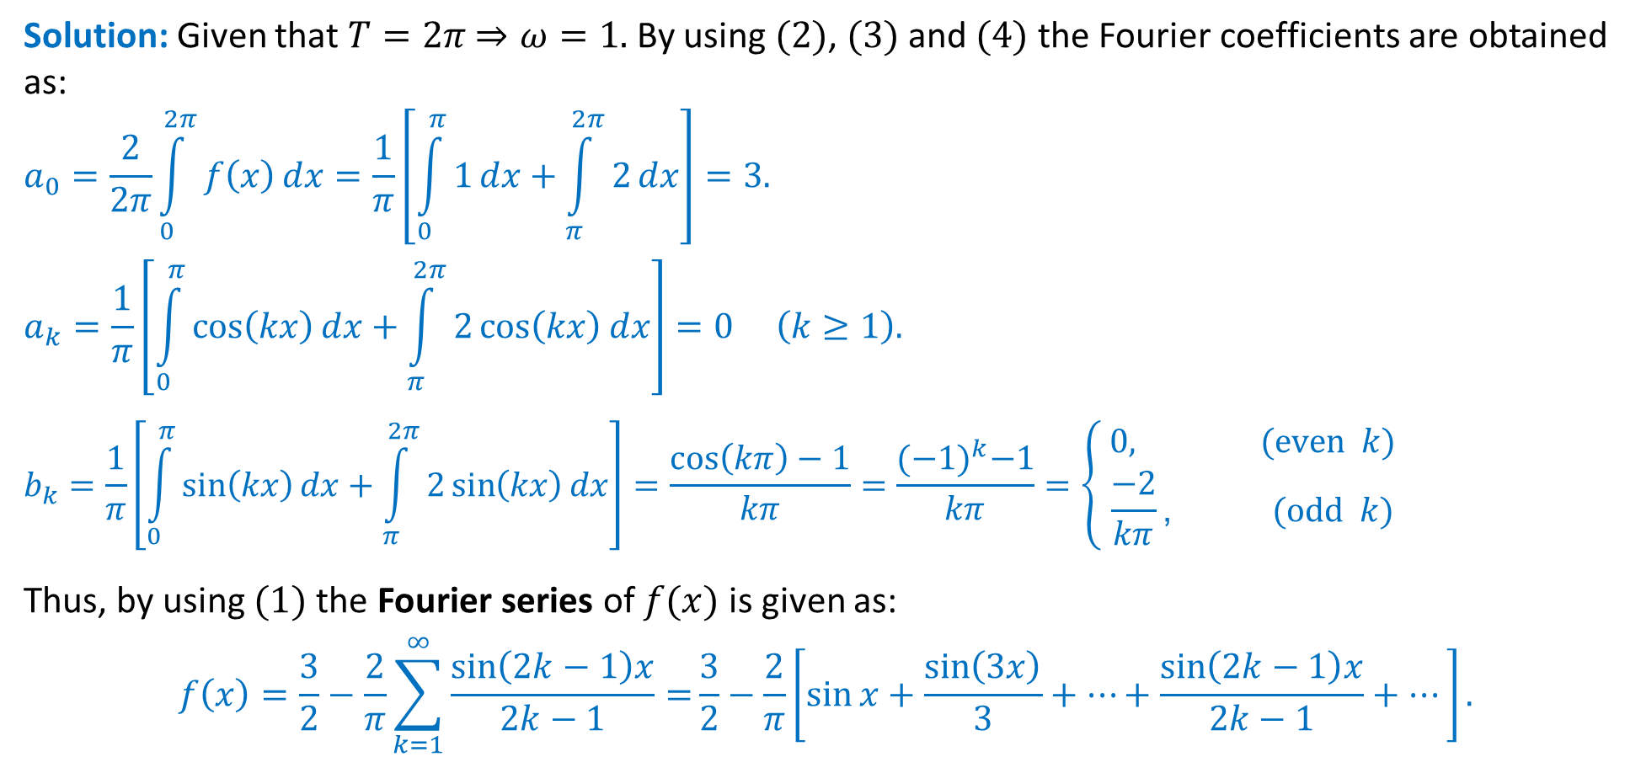
Example: Obtain the Fourier series expansion of the periodic function $f\left(x\right)=\left\{\begin{matrix}1, 0≤x≤π \\ 2, π≤x≤2π\end{matrix}\right.$
Solution: Given that $T=2π$ $⇒ω=1.$ By using $(2)$, $(3)$ and $(4)$ the Fourier coefficients are obtained as:
$$a_{0}=\frac{2}{2π}\int_{0}^{2π}{f\left(x\right)}dx=\frac{1}{π}\left[\int_{0}^{π}{1}dx+\int_{π}^{2π}{2}dx\right]=3.$$
$$a_{k}=\frac{1}{π}\left[\int_{0}^{π}{\cos\left(kx\right)}dx+\int_{π}^{2π}{2\cos\left(kx\right)}dx\right]=0 \left(k≥1\right).$$
$$b_{k}=\frac{1}{π}\left[\int_{0}^{π}{\sin\left(kx\right)}dx+\int_{π}^{2π}{2\sin\left(kx\right)}dx\right]=\frac{\cos\left(kπ\right)−1}{kπ}=\frac{{(−1)}^{k}−1}{kπ}=\left\{\begin{matrix} 0, (even k) \\ \frac{−2}{kπ}\text{,} (odd k)\end{matrix}\right.$$
Thus, by using $(1)$ the Fourier series of $f(x)$ is given as:
$$f\left(x\right)=\frac{3}{2}−\frac{2}{π}\sum_{k=1}^{∞}{\frac{\sin\left(2k−1\right)x}{2k−1}=}\frac{3}{2}−\frac{2}{π}\left[\sin{x}+\frac{\sin\left(3x\right)}{3}+…+\frac{\sin\left(2k−1\right)x}{2k−1}+…\right].$$
The graph of the Fourier series for $f(x)$ is periodic and has the value $3/2$ at each point of discontinuity .

Slide 19
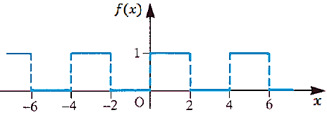
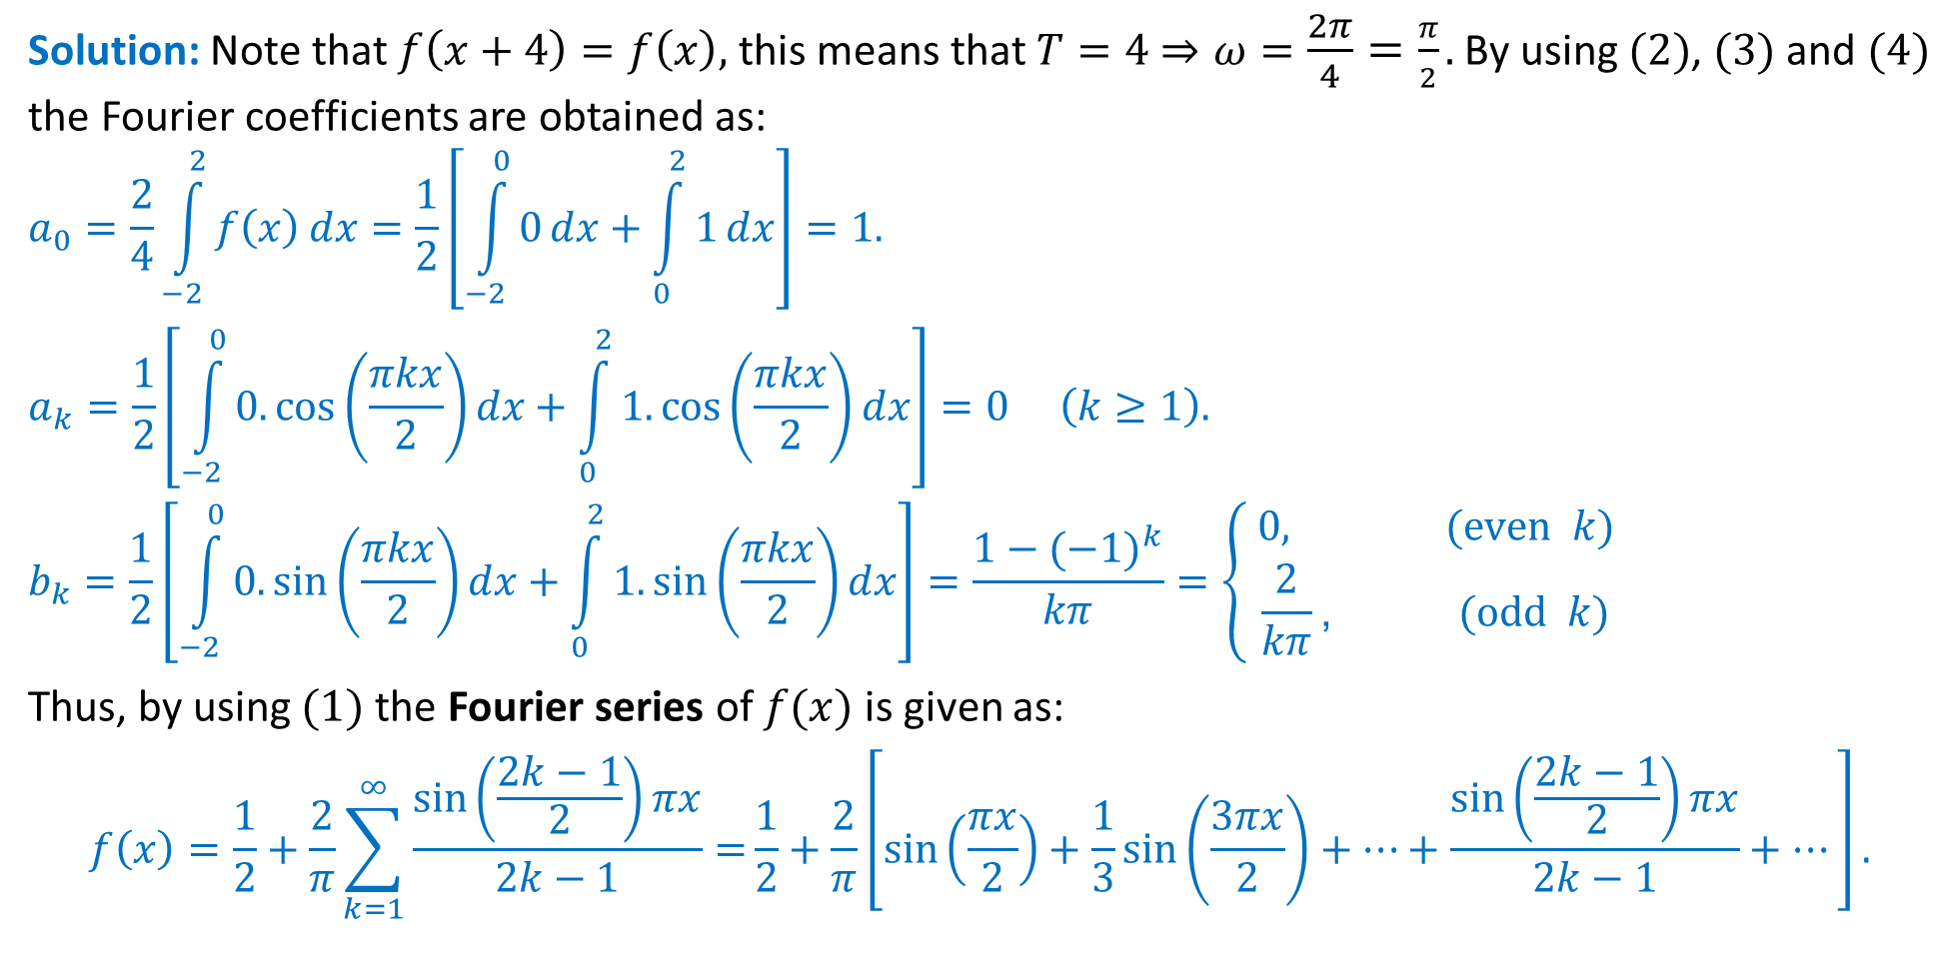
Example: Obtain the Fourier series expansion of the periodic function $f\left(x\right)=\left\{\begin{matrix}0, −2≤x≤0 \\ 1, 0≤x≤2\end{matrix}\right.$
Solution: Note that $f\left(x+4\right)=f\left(x\right),$ this means that $T=4$ $⇒ω=\frac{2π}{4}=\frac{π}{2}.$ By using $(2)$, $(3)$ and $(4)$ the Fourier coefficients are obtained as:
$$a_{0}=\frac{2}{4}\int_{−2}^{2}{f\left(x\right)}dx=\frac{1}{2}\left[\int_{−2}^{0}{0}dx+\int_{0}^{2}{1}dx\right]=1.$$
$$a_{k}=\frac{1}{2}\left[\int_{−2}^{0}{0.\cos\left(\frac{πkx}{2}\right)}dx+\int_{0}^{2}{1. \cos\left(\frac{πkx}{2}\right)}dx\right]=0 \left(k≥1\right).$$
$$b_{k}=\frac{1}{2}\left[\int_{−2}^{0}{0.\sin\left(\frac{πkx}{2}\right)}dx+\int_{0}^{2}{1. \sin\left(\frac{πkx}{2}\right)}dx\right]=\frac{1−{(−1)}^{k}}{kπ}=\left\{\begin{matrix} 0, (even k) \\ \frac{2}{kπ}\text{,} (odd k)\end{matrix}\right.$$
Thus, by using $(1)$ the Fourier series of $f(x)$ is given as:
$$f\left(x\right)=\frac{1}{2}+\frac{2}{π}\sum_{k=1}^{∞}{\frac{\sin\left(\frac{2k−1}{2}\right)πx}{2k−1}=}\frac{1}{2}+\frac{2}{π}\left[\sin\left(\frac{πx}{2}\right)+\frac{1}{3}\sin\left(\frac{3πx}{2}\right)+…+\frac{\sin\left(\frac{2k−1}{2}\right)πx}{2k−1}+…\right].$$

Slide 20
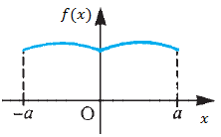
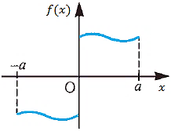
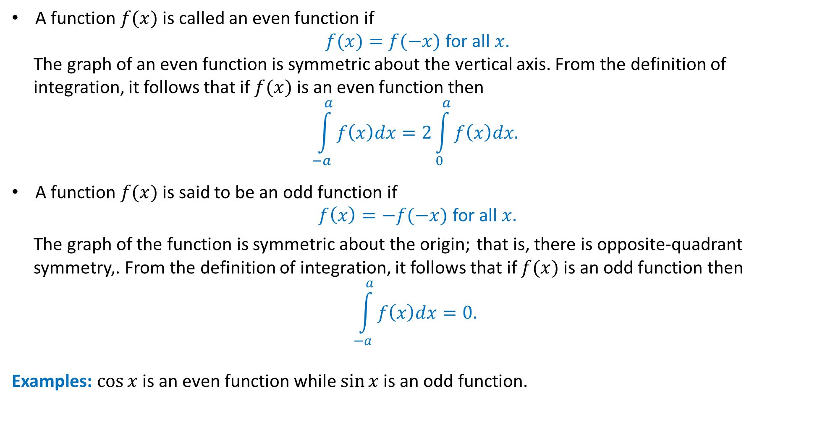
Even and odd functions
A function $f(x)$ is called an even function if
$f(x)=f(−x)$ for all $x.$
The graph of an even function is symmetric about the vertical axis. From the definition of
integration, it follows that if $f(x)$ is an even function then
$$\int_{−a}^{a}{f\left(x\right)dx=2\int_{0}^{a}{f\left(x\right)dx.}}$$
A function $f(x)$ is said to be an odd function if
$f\left(x\right)=−f(−x)$ for all $x.$
The graph of the function is symmetric about the origin; that is, there is opposite-quadrant
symmetry,. From the definition of integration, it follows that if $f(x)$ is an odd function then
$$\int_{−a}^{a}{f\left(x\right)dx=0.}$$
Examples: $\cos{x}$ is an even function while $\sin{x}$is an odd function.

Slide 21
Properties of Even and odd functions
The following properties of even and odd functions are also useful for our purposes:
(a) the sum of two (or more) odd functions is an odd function;
(b) the product of two even functions is an even function;
(c) the product of two odd functions is an even function;
(d) the product of an odd and an even function is an odd function;
(e) the derivative of an even function is an odd function;
(f) the derivative of an odd function is an even function.

Slide 22
Fourier cosine series
If $f(x)$ is an even periodic function of period $T$ then by using property (b), we have
$$a_{k}=\frac{2}{T}\int_{−T/2}^{T/2}{f(x)}\cos\left(kωx\right)dx=\frac{4}{T}\int_{0}^{T/2}{f(x)}\cos\left(kωx\right)dx,$$
and by using property (d)
$$b_{k}=\frac{2}{T}\int_{−T/2}^{T/2}{f(x)}\sin\left(kωx\right)dx=0.$$
Thus the Fourier series expansion of an even periodic function $f(x)$ with period $T$ consists of cosine terms only and is given by:
$$f\left(x\right)=\frac{a_{0}}{2}+ \sum_{k=1}^{∞}{a_{k}\cos\left(kωx\right),} (5)$$
with
$$a_{0}=\frac{4}{T}\int_{0}^{T/2}{f(x)}dx and a_{k}=\frac{4}{T}\int_{0}^{T/2}{f(x)}\cos\left(kωx\right)dx, \left(k≥1\right). \left(6\right)$$

Slide 23
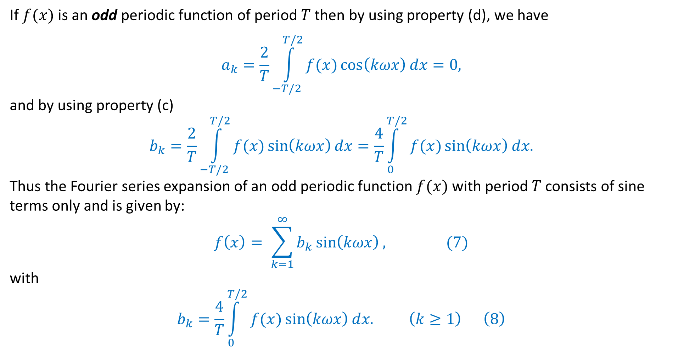
Fourier sine series
If $f(x)$ is an odd periodic function of period $T$ then by using property (d), we have
$$a_{k}=\frac{2}{T}\int_{−T/2}^{T/2}{f(x)}\cos\left(kωx\right)dx=0,$$
and by using property (c)
$$b_{k}=\frac{2}{T}\int_{−T/2}^{T/2}{f(x)}\sin\left(kωx\right)dx=\frac{4}{T}\int_{0}^{T/2}{f(x)}\sin\left(kωx\right)dx.$$
Thus the Fourier series expansion of an odd periodic function $f(x)$ with period $T$ consists of sine terms only and is given by:
$$f\left(x\right)= \sum_{k=1}^{∞}{b_{k}\sin\left(kωx\right),} (7)$$
with
$$b_{k}=\frac{4}{T}\int_{0}^{T/2}{f(x)}\sin\left(kωx\right)dx. \left(k≥1\right) \left(8\right)$$

Slide 24
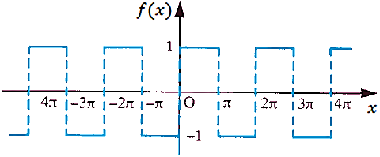
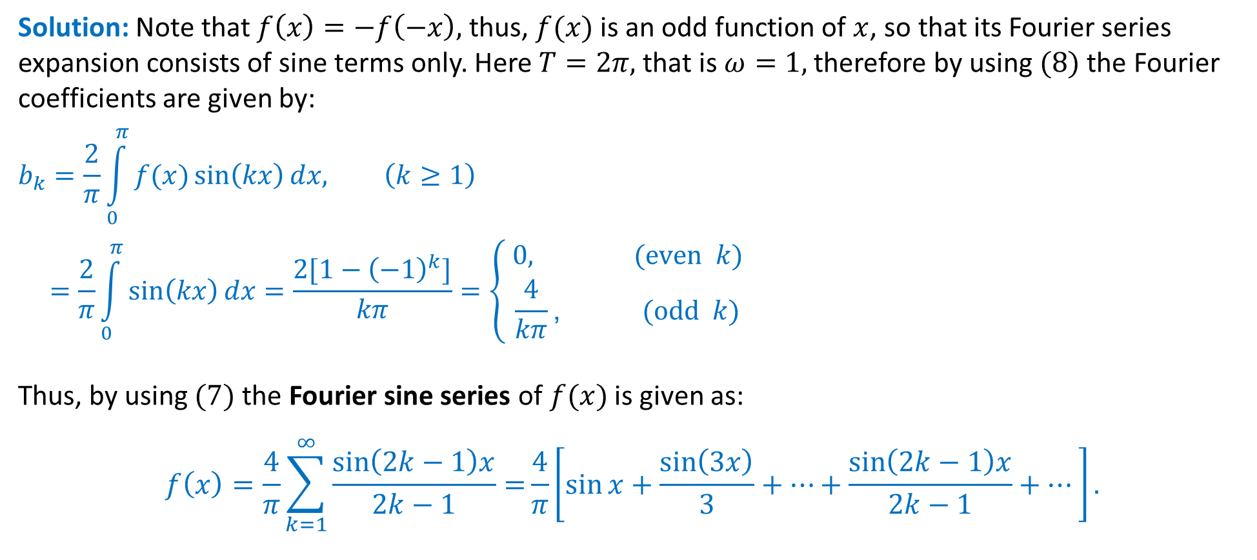
Example: Obtain the Fourier series expansion of the periodic function $f\left(x\right)=\left\{\begin{matrix}−1,−π≤x≤0 \\ 1, 0≤x≤π\end{matrix}\right.$
Solution: Note that $f\left(x\right)=−f\left(−x\right),$ thus, $f(x)$ is an odd function of $x$, so that its Fourier series expansion consists of sine terms only. Here $T=2π,$ that is $ω=1,$ therefore by using $(8)$ the Fourier coefficients are given by:
$$b_{k}=\frac{2}{π}\int_{0}^{π}{f(x)\sin\left(kx\right)}dx, \left(k≥1\right)$$
$$=\frac{2}{π}\int_{0}^{π}{\sin\left(kx\right)}dx=\frac{2[1−{\left(−1\right)}^{k}]}{kπ}=\left\{\begin{matrix} 0, (even k) \\ \frac{4}{kπ}\text{,} (odd k)\end{matrix}\right.$$
Thus, by using $(7)$ the Fourier sine series of $f(x)$ is given as:
$$f\left(x\right)=\frac{4}{π}\sum_{k=1}^{∞}{\frac{\sin\left(2k−1\right)x}{2k−1}=}\frac{4}{π}\left[\sin{x}+\frac{\sin\left(3x\right)}{3}+…+\frac{\sin\left(2k−1\right)x}{2k−1}+…\right].$$
Square wave function

Slide 25
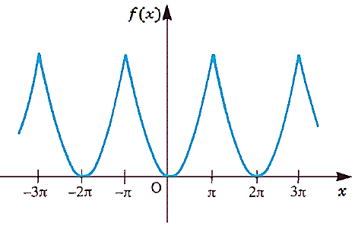
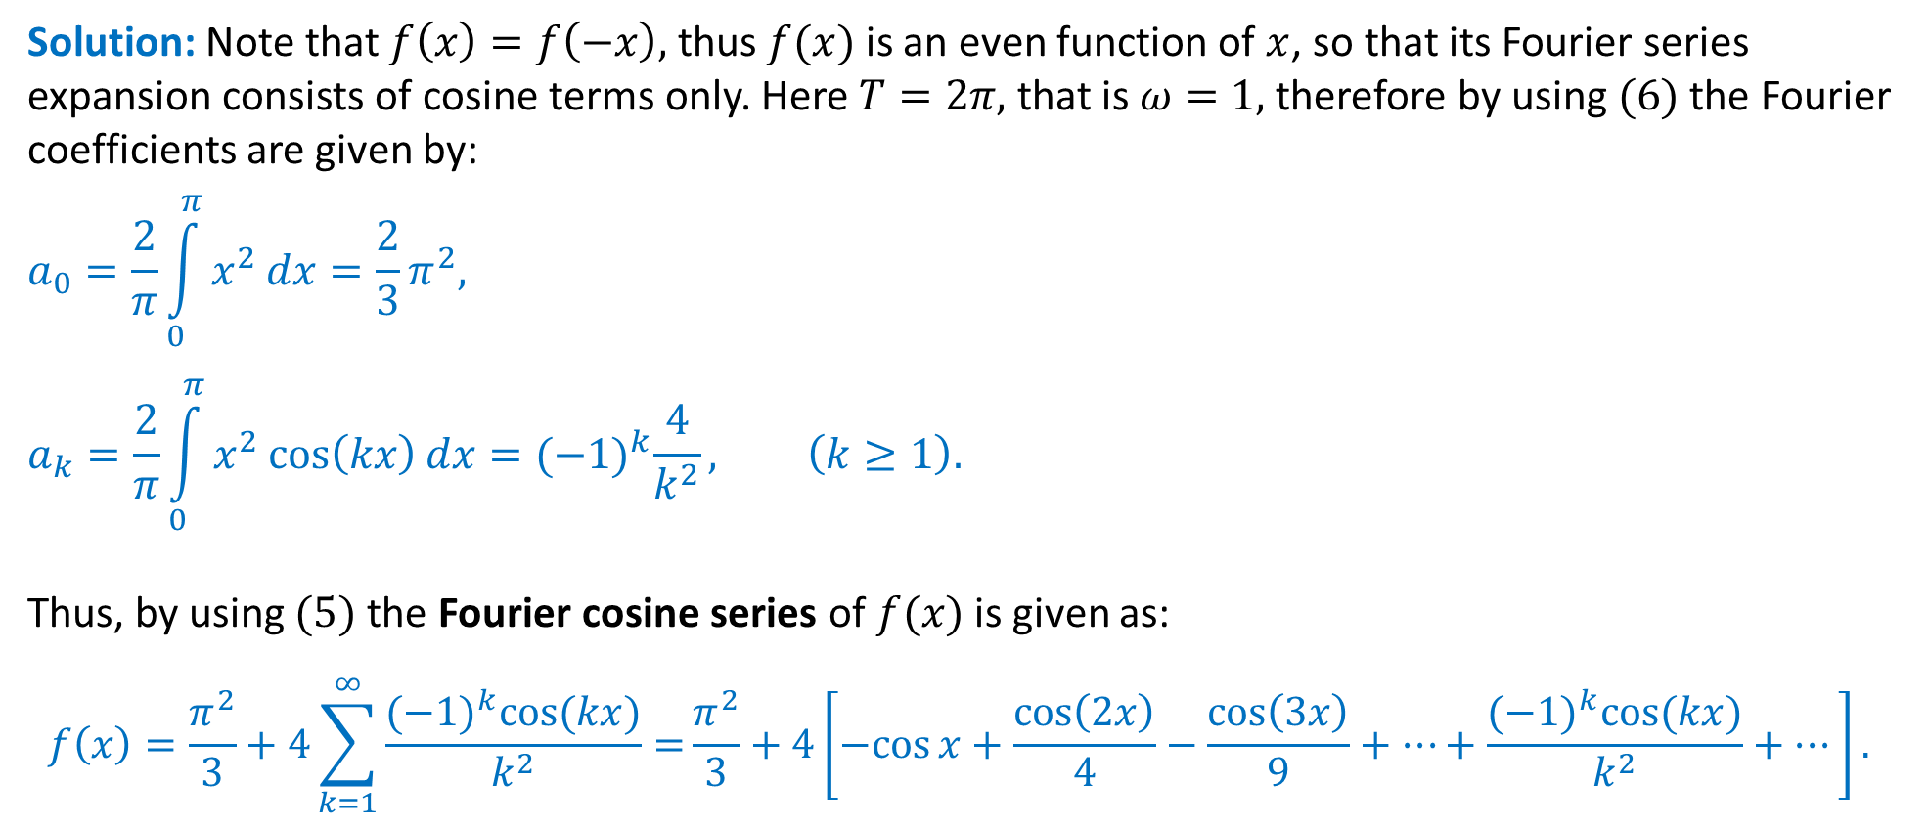
Example: Obtain the Fourier series expansion of the periodic function $f\left(x\right)=x^{2},−π≤x≤π$
Solution: Note that $f\left(x\right)=f\left(−x\right),$ thus $f(x)$ is an even function of $x$, so that its Fourier series expansion consists of cosine terms only. Here $T=2π,$ that is $ω=1,$ therefore by using $(6)$ the Fourier coefficients are given by:
$$a_{0}=\frac{2}{π}\int_{0}^{π}{x^{2}}dx=\frac{2}{3}π^{2},$$
$$a_{k}=\frac{2}{π}\int_{0}^{π}{x^{2}\cos\left(kx\right)}dx={(−1)}^{k}\frac{4}{k^{2}}, \left(k≥1\right).$$
Thus, by using $(5)$ the Fourier cosine series of $f(x)$ is given as:
$$f\left(x\right)=\frac{π^{2}}{3}+4\sum_{k=1}^{∞}{\frac{{(−1)}^{k}\cos{(kx)}}{k^{2}}=}\frac{π^{2}}{3}+4\left[−cos{x}+\frac{\cos\left(2x\right)}{4}−\frac{\cos\left(3x\right)}{9}+…+\frac{{(−1)}^{k}\cos{(kx)}}{k^{2}}+…\right].$$

Slide 26
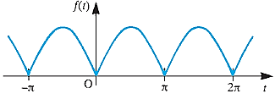
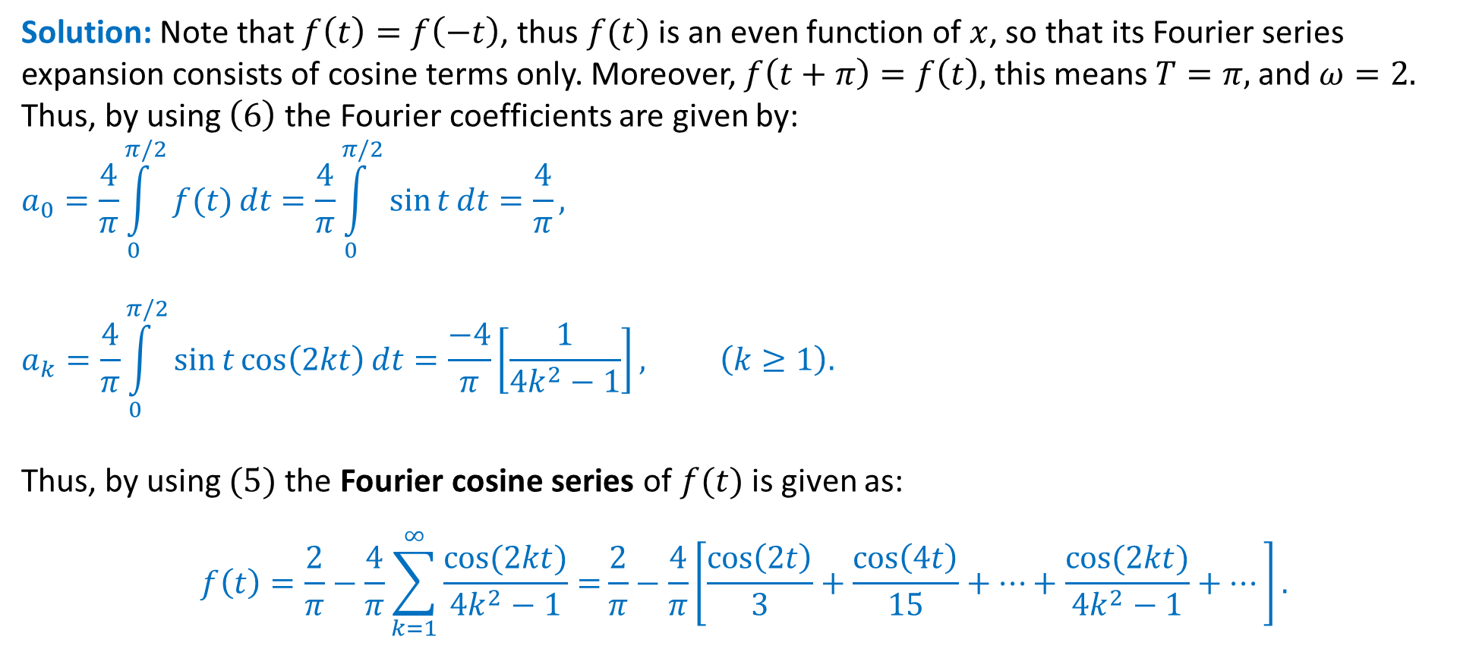

Example: Obtain the Fourier series expansion of the rectified sine wave $f\left(t\right)=\left|\sin{t}\right|$ and Sketch of the wave over the interval $−π≤ t≤ 2π.$
Solution: Note that $f\left(t\right)=f\left(−t\right)$, thus $f(t)$ is an even function of $x$, so that its Fourier series expansion consists of cosine terms only. Moreover, $f\left(t+π\right)=f\left(t\right),$ this means $T=π,$ and $ω=2.$ Thus, by using $\left(6\right)$ the Fourier coefficients are given by:
$$a_{0}=\frac{4}{π}\int_{0}^{π/2}{f(t)}dt=\frac{4}{π}\int_{0}^{π/2}{\sin{t}}dt=\frac{4}{π},$$
$$a_{k}=\frac{4}{π}\int_{0}^{π/2}{\sin{t}\cos\left(2kt\right)}dt=\frac{−4}{π}\left[\frac{1}{{4k}^{2}−1}\right], \left(k≥1\right).$$
Thus, by using $(5)$ the Fourier cosine series of $f(t)$ is given as:
$$f\left(t\right)=\frac{2}{π}−\frac{4}{π}\sum_{k=1}^{∞}{\frac{\cos{(2kt)}}{{4k}^{2}−1}=}\frac{2}{π}−\frac{4}{π}\left[\frac{\cos\left(2t\right)}{3}+\frac{\cos\left(4t\right)}{15}+…+\frac{\cos{(2kt)}}{{4k}^{2}−1}+…\right].$$
Rectified wave $f(t)=|\sin{t}|$.

Slide 27
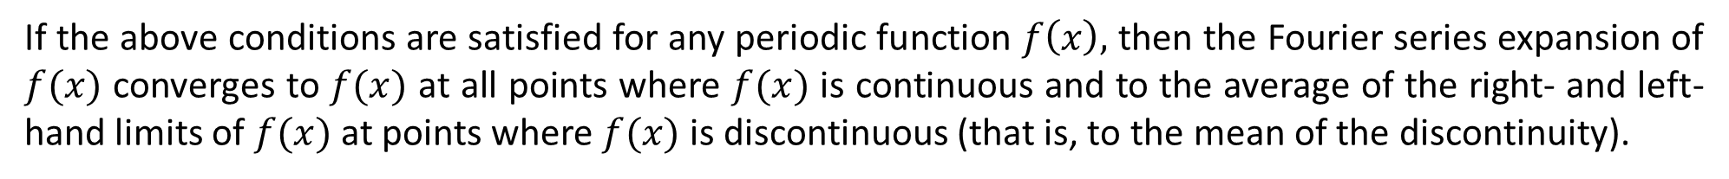
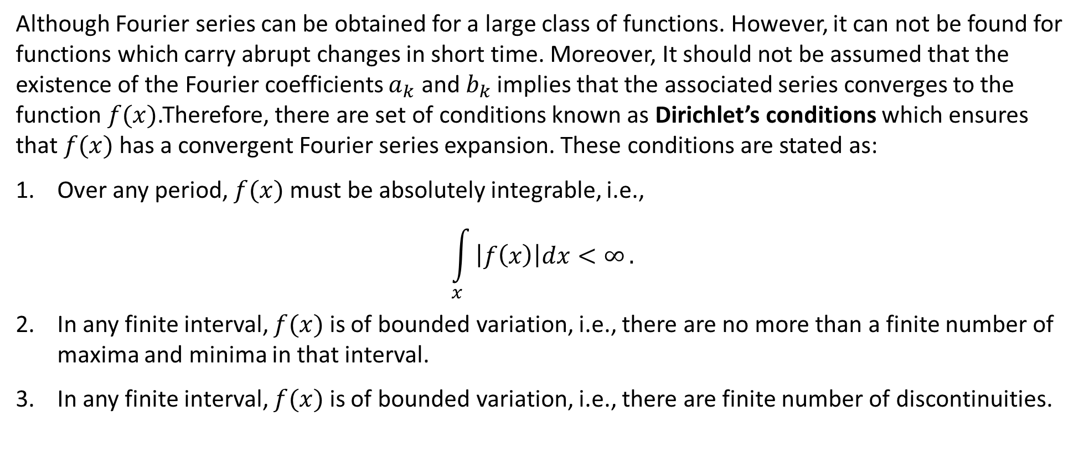
Existence & Convergence of Fourier Series
Although Fourier series can be obtained for a large class of functions. However, it can not be found for functions which carry abrupt changes in short time. Moreover, It should not be assumed that the existence of the Fourier coefficients $a_{k}$ and $b_{k}$ implies that the associated series converges to the
function $f(x)$.Therefore, there are set of conditions known as Dirichlet’s conditions which ensures that $f(x)$ has a convergent Fourier series expansion. These conditions are stated as:
Over any period, $f(x)$ must be absolutely integrable, i.e.,
$$\int_{x}{\left|f\left(x\right)\right|dx<∞}.$$
In any finite interval, $f(x)$ is of bounded variation, i.e., there are no more than a finite number of maxima and minima in that interval.
In any finite interval, $f(x)$ is of bounded variation, i.e., there are finite number of discontinuities.
If the above conditions are satisfied for any periodic function $f\left(x\right),$ then the Fourier series expansion of $f(x)$ converges to $f(x)$ at all points where $f(x)$ is continuous and to the average of the right- and left-hand limits of $f(x)$ at points where $f(x)$ is discontinuous (that is, to the mean of the discontinuity).

Slide 28
Fourier Series
For a periodic function $f(x)$ of period $T,$ the Fourier series is given in terms of harmonics as:
$$f\left(x\right)=\frac{a_{0}}{2}+\left[a_{1}\cos\left(ωx\right)+b_{1}\sin\left(ωx\right)\right]+\left[a_{2}\cos\left(2ωx\right)+b_{2}\sin\left(2ωx\right)\right]+…$$
$$f\left(x\right)=\frac{a_{0}}{2}+ \sum_{k=1}^{∞}{\left[a_{k}\cos\left(kωx\right)+b_{k}\sin\left(kωx\right)\right],}$$
where $ω=\frac{2π}{T}$ and $a_{0},a_{k}$ & $b_{k}$ are the Fourier coefficients.
The Fourier series of an even periodic function is known as Fourier cosine series ($b_{k}=0$).
The Fourier series of an odd periodic function is known as Fourier sine series ($a_{0}=0,a_{k}=0$).
A natural question arises:
Can we generalize this idea to include functions that are not periodic?
And the answer is:
Yes!!!
first mode
second mode

Slide 29
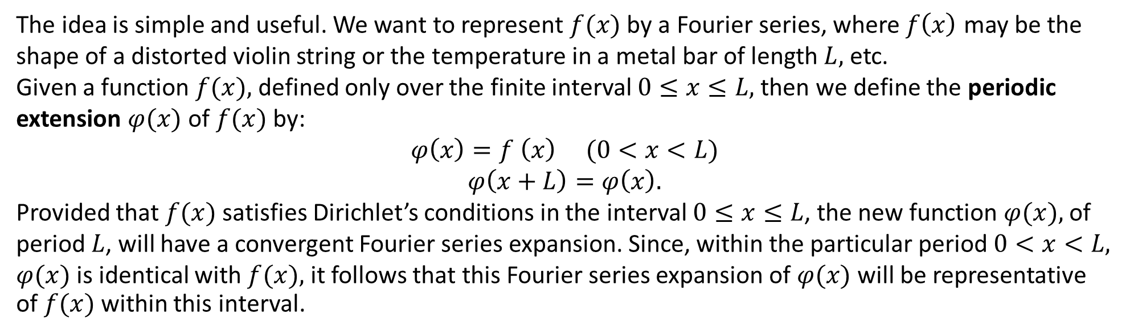
Fourier Series
There are two ways to do it.
Half-range expansions.
Fourier transforms
Since the main purpose is to divide the function (signal) in small oscillations, therefore, it can easily be done for functions defined on some intervals. As soon as the Fourier series is obtained which is valid for all values of $x$, we can restrict it in the interval of our interest and make use of oscillations.
Periodic Extension
The idea is simple and useful. We want to represent $f(x)$ by a Fourier series, where $f\left(x\right)$ may be the shape of a distorted violin string or the temperature in a metal bar of length $L,$ etc.
Given a function $f(x),$ defined only over the finite interval $0≤x≤L,$ then we define the periodic extension $φ(x)$ of $f(x)$ by:
$$φ\left(x\right)=f \left(x\right) (0<x<L)$$
$$φ\left(x+L\right)=φ\left(x\right).$$
Provided that $f(x)$ satisfies Dirichlet’s conditions in the interval $0≤x≤L$, the new function $φ(x),$ of period $L$, will have a convergent Fourier series expansion. Since, within the particular period $0<x<L,$ $φ(x)$ is identical with $f(x),$ it follows that this Fourier series expansion of $φ(x)$ will be representative of $f(x)$ within this interval.

Slide 30
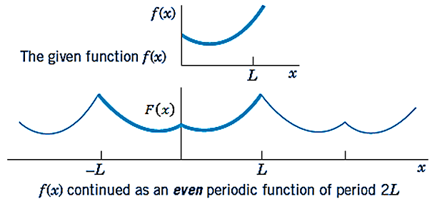
Half-range expansions
Given a function $f(x),$ defined only over the finite interval $0≤x≤L$ then we can extend the function on the left in such a way that the extended function becomes symmetric about $y−$axis which gives rise to an even periodic extension of $f(x)$ defined by:
$F\left(x\right)=\left\{\begin{aligned}f\left(x\right) (0≤x≤L) \\ f\left(−x\right) (−L<x<0)\end{aligned}\right.$
$F\left(x+2L\right)=F\left(x\right),$
provided that $f(x)$ satisfies Dirichlet’s conditions in the interval $0<x<L$, since it is an even function of period $2L$, it follows that the even periodic extension $F(x)$ will have a convergent Fourier series representation consisting of cosine terms only. Since, within the interval $0<x<L$, $F(x)$ is identical with $f(x)$, it follows that the resulting Fourier cosine series also converges to $f(x)$ within this interval.

Slide 31
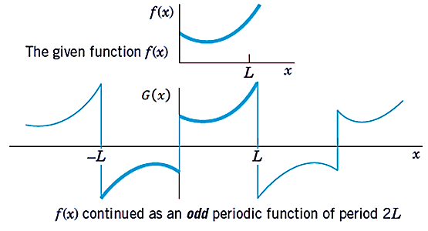
Half-range expansions
Similarly, given a function $f(x),$ defined only over the finite interval $0≤x≤L$ then we can extend the function on the left such that the extended function becomes symmetric about origin which is known as an odd periodic extension of $f\left(x\right),$ defined by:
$G\left(x\right)=\left\{\begin{aligned}f\left(x\right) (0≤x≤L) \\ −f\left(−x\right) (−L<x<0)\end{aligned}\right.$
$G\left(x+2L\right)=G\left(x\right),$
provided that $f(x)$ satisfies Dirichlet’s conditions in the interval $0<x<L$, since it is an odd function of period $2L$, it follows that the odd periodic extension $G(x)$ will have a convergent Fourier series representation consisting of sine terms only. Since, within the interval $0<x<L$, $F(x)$ is identical with $f(x)$, it follows that the resulting Fourier sine series also converges to $f(x)$ within this interval.
Note: Since Both extensions have period $2L$. This motivates the name half-range expansions: $f(x)$ is given only on half the range, that is, on half the interval of periodicity of length $2L$.

Slide 32
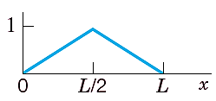
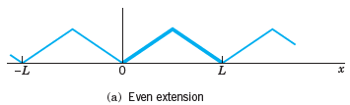
Example: Find the two half-range expansions of the function:
$$f\left(x\right)=\left\{\begin{aligned}\frac{2}{L}x \left(0<x<\frac{L}{2}\right) \\ \frac{2}{L}\left(L−x\right) \left(\frac{L}{2}<x<L\right)\end{aligned}\right.$$
$(a)$Even periodic extension:
$$F\left(x\right)=\left\{\begin{aligned}f\left(x\right) (0<x<L) \\ f\left(−x\right) (−L<x<0)\end{aligned}\right.; F\left(x+2L\right)=F\left(x\right).$$
Since $F(x)$ is an even periodic function with period $2L$, it has a convergent Fourier series expansion given by:
$$F\left(x\right)=\frac{a_{0}}{2}+ \sum_{k=1}^{∞}{a_{k}\cos\left(kωx\right),} (1)$$
with
$$a_{0}=\frac{2}{L}\int_{0}^{L}{F(x)}dx and a_{k}=\frac{2}{L}\int_{0}^{L}{F(x)}\cos\left(kωx\right)dx, \left(k≥1\right). \left(2\right)$$

Slide 33
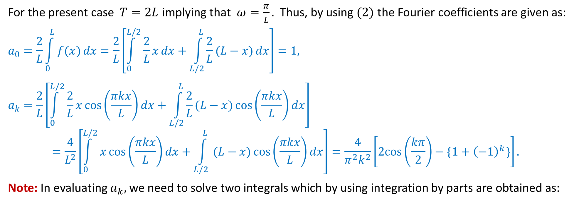
For the present case $T=2L$ implying that $ω=\frac{π}{L}.$ Thus, by using $(2)$ the Fourier coefficients are given as:
$$a_{0}=\frac{2}{L}\int_{0}^{L}{f(x)}dx=\frac{2}{L}\left[\int_{0}^{L/2}{\frac{2}{L}x}dx+\int_{L/2}^{L}{\frac{2}{L}(L−x)}dx\right]=1,$$
$$a_{k}=\frac{2}{L}\left[\int_{0}^{L/2}{\frac{2}{L}x\cos\left(\frac{πkx}{L}\right)}dx+\int_{L/2}^{L}{\frac{2}{L}(L−x)\cos\left(\frac{πkx}{L}\right)}dx\right]=\frac{4}{L^{2}}\left[\int_{0}^{L/2}{x\cos\left(\frac{πkx}{L}\right)}dx+\int_{L/2}^{L}{ (L−x)\cos\left(\frac{πkx}{L}\right)}dx\right]=\frac{4}{π^{2}k^{2}}\left[2cos\left(\frac{kπ}{2}\right)−\{1+{\left(−1\right)}^{k}\}\right].$$
Note: In evaluating $a_{k},$ we need to solve two integrals which by using integration by parts are obtained as:
$$\int_{0}^{L/2}{x\cos\left(\frac{πkx}{L}\right)}dx=\frac{L^{2}}{2kπ}\sin\left(\frac{kπ}{2}\right)+ \frac{L^{2}}{π^{2}k^{2}}\left[\cos\left(\frac{kπ}{2}\right)−1\right]$$
$$\int_{L/2}^{L}{ (L−x)\cos\left(\frac{πkx}{L}\right)}dx=\frac{{−L}^{2}}{2kπ}\sin\left(\frac{kπ}{2}\right)+ \frac{L^{2}}{π^{2}k^{2}}\left[\cos\left(\frac{kπ}{2}\right)−\cos{(kπ)}\right]=\frac{{−L}^{2}}{2kπ}\sin\left(\frac{kπ}{2}\right)+ \frac{L^{2}}{π^{2}k^{2}}\left[\cos\left(\frac{kπ}{2}\right)−{\left(−1\right)}^{k}\right]$$

Slide 34
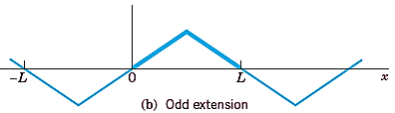
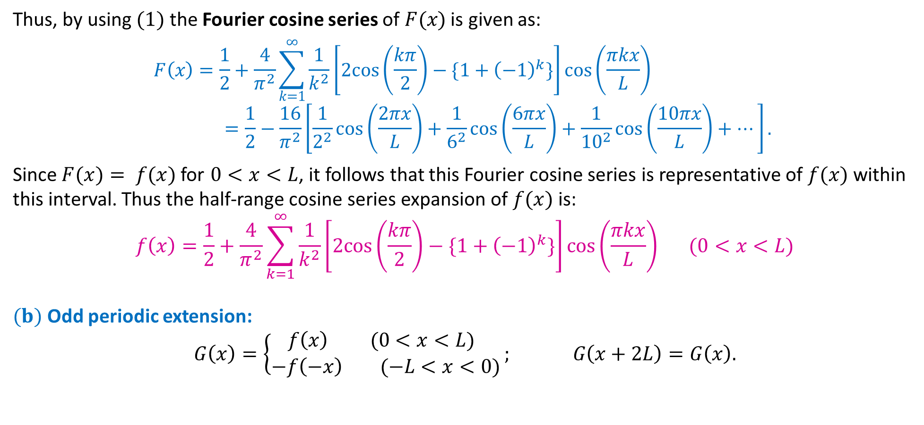
Thus, by using $(1)$ the Fourier cosine series of $F(x)$ is given as:
$$F\left(x\right)=\frac{1}{2}+\frac{4}{π^{2}}\sum_{k=1}^{∞}{\frac{1}{k^{2}}\left[2cos\left(\frac{kπ}{2}\right)−\{1+{\left(−1\right)}^{k}\}\right]}\cos\left(\frac{πkx}{L}\right)=\frac{1}{2}−\frac{16}{π^{2}}\left[\frac{1}{2^{2}}\cos\left(\frac{2πx}{L}\right)+\frac{1}{6^{2}}\cos\left(\frac{6πx}{L}\right)+\frac{1}{{10}^{2}}\cos\left(\frac{10πx}{L}\right)+…\right].$$
Since $F(x)= f(x)$ for $0<x<L$, it follows that this Fourier cosine series is representative of $f(x)$ within this interval. Thus the half-range cosine series expansion of $f(x)$ is:
$$f\left(x\right)=\frac{1}{2}+\frac{4}{π^{2}}\sum_{k=1}^{∞}{\frac{1}{k^{2}}\left[2cos\left(\frac{kπ}{2}\right)−\{1+{\left(−1\right)}^{k}\}\right]}\cos\left(\frac{πkx}{L}\right) (0<x<L)$$
$(b)$Odd periodic extension:
$$G\left(x\right)=\left\{\begin{aligned}f\left(x\right) (0<x<L) \\ −f\left(−x\right) (−L<x<0)\end{aligned}\right.; G\left(x+2L\right)=G\left(x\right).$$

Slide 35

Since $F(x)$ is an odd periodic function with period $2L$, it has a convergent Fourier series expansion given by:
$$G\left(x\right)= \sum_{k=1}^{∞}{b_{k}\sin\left(kωx\right),} \left(3\right) with b_{k}=\frac{2}{L}\int_{0}^{L}{G(x)}\sin\left(kωx\right)dx, \left(k≥1\right). \left(4\right)$$
By using $(2)$ the Fourier coefficients are given as:
$$b_{k}=\frac{2}{L}\left[\int_{0}^{L/2}{\frac{2}{L}x\sin\left(\frac{πkx}{L}\right)}dx+\int_{L/2}^{L}{\frac{2}{L}(L−x)\sin\left(\frac{πkx}{L}\right)}dx\right]=\frac{8}{π^{2}k^{2}}\sin\left(\frac{kπ}{2}\right).$$
Thus, by using $(3)$ the Fourier sine series of $G(x)$ is given as:
$$G\left(x\right)=\frac{8}{π^{2}}\sum_{k=1}^{∞}{\frac{1}{k^{2}}\sin\left(\frac{kπ}{2}\right)}\sin\left(\frac{πkx}{L}\right)=\frac{8}{π^{2}}\left[\sin\left(\frac{πx}{L}\right)−\frac{1}{3^{2}}\sin\left(\frac{3πx}{L}\right)+\frac{1}{5^{2}}\sin\left(\frac{5πx}{L}\right)−…\right].$$
Since $G(x)= f(x)$ for $0<x<L$, it follows that this Fourier sine series is representative of $f(x)$ within this interval. Thus the half-range sine series expansion of $f(x)$ is:
$$f\left(x\right)=\frac{8}{π^{2}}\sum_{k=1}^{∞}{\frac{1}{k^{2}}\sin\left(\frac{kπ}{2}\right)}\sin\left(\frac{πkx}{L}\right) (0<x<L)$$

Slide 36
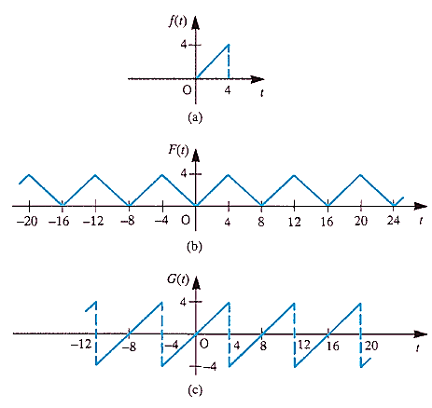
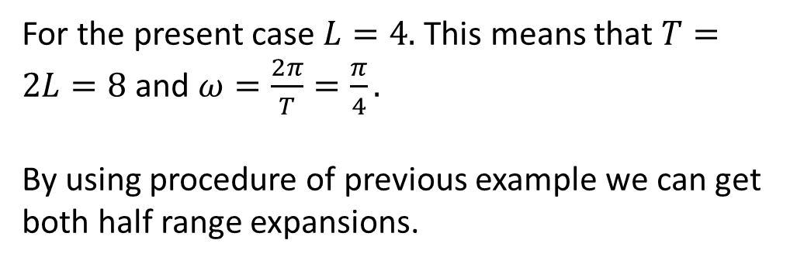
Example:
For the function $f(t) = t$ defined only in the interval $0<t<4$, obtain
(a) a half-range cosine series expansion
(b) a half-range sine series expansion.
Draw graphs of $f(t)$ and of the periodic functions
represented by the two series obtained for $−20< t< 20.$
Solution:
For the present case $L=4.$ This means that $T=2L=8$ and $ω=\frac{2π}{T}=\frac{π}{4}.$
By using procedure of previous example we can get both half range expansions.

Slide 37
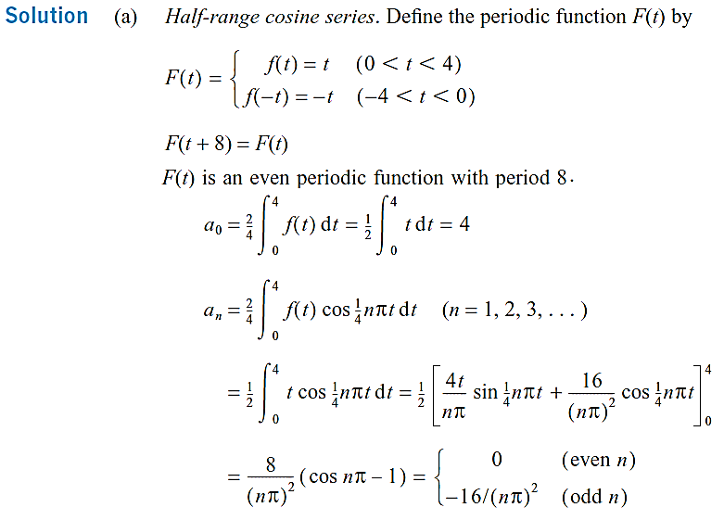

Slide 38
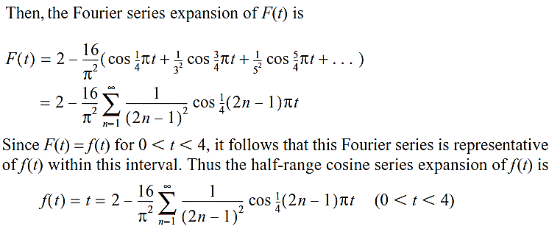

Slide 39
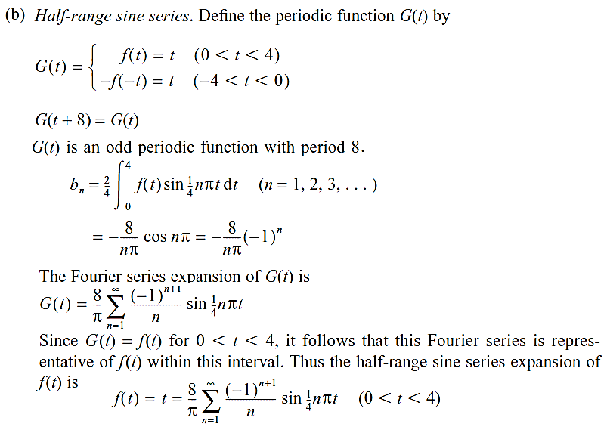

Slide 40
Book: Advanced Modern Engineering Mathematics (4th Edition) by Glyn James
Chapter: 7
Sections: 7.6
Book: Signals and Systems (2nd Edition) by Alan V. Oppenheim, Alan S. Willsky, and S. Hamid Nawab
Chapter: 3
Sections: 3.3

Slide 41
Complex form of Fourier series
An alternative to the trigonometric form of the Fourier series considered so far is the complex or exponential form.
As a result of the properties of the exponential function, this form is easily manipulated mathematically.
It is widely used by engineers in practice, particularly in work involving signal analysis, and provides a smoother transition from the consideration of Fourier series for dealing with periodic signals to the consideration of Fourier transforms for dealing with aperiodic signals.
Complex representation
The complex form of the Fourier series expansion of a periodic function $f(x)$, of period $T$, is
$$f\left(x\right)=c_{0}+\sum_{k=1}^{∞}{c_{k}e^{ikωx}}+\sum_{k=−∞}^{−1}{c_{k}e^{ikωx}}=\sum_{k=−∞}^{∞}{c_{k}e^{ikωx}}; c_{0}e^{0}=c_{0} (1)$$
where the complex coefficients are given by:
$$c_{0}=\frac{1}{T}\int_{x_{0}}^{x_{0}+T}{f\left(x\right)}dx and c_{k}=\frac{1}{T}\int_{x_{0}}^{x_{0}+T}{f\left(x\right)e^{−ikωx}}dx \left(k=±1,±2,…\right) (2)$$

Slide 42
Complex form of Fourier Series
For a periodic function $f(x)$ of period $T,$ the Fourier series is given in terms of harmonics as:
$$f\left(x\right)=\frac{a_{0}}{2}+ \sum_{k=1}^{∞}{\left[a_{k}\cos\left(kωx\right)+b_{k}\sin\left(kωx\right)\right]} (3)$$
where $ω=\frac{2π}{T}$ and $a_{0},a_{k}$ & $b_{k}$ are the Fourier coefficients. To develop the complex form of the Fourier series we proceed as follows. Substituting the results:
$$sin \left(kωx\right)=\frac{e^{ikωx}−e^{−ikωx}}{2i} and cos \left(kωx\right)=\frac{e^{ikωx}+e^{−ikωx}}{2}$$
in $(1)$ and simplifying we get:
$$f\left(x\right)=\frac{a_{0}}{2}+ \sum_{k=1}^{∞}{\left[\frac{a_{k}−ib_{k}}{2}e^{ikωx}+\frac{a_{k}+ib_{k}}{2}e^{−ikωx}\right]} (4)$$
$Let \frac{a_{0}}{2}=c_{0}, c_{k}=\frac{a_{k}−ib_{k}}{2} and c_{−k}=\overline{c_{k}}=\frac{a_{k}+ib_{k}}{2} (5)$
Using (3) in (2) we get:
$$f\left(x\right)=c_{0}+ \sum_{k=1}^{∞}{c_{k}e^{ikωx}+ \sum_{k=1}^{∞}{c_{−k}e^{−ikωx}}}=c_{0}+ \sum_{k=1}^{∞}{c_{k}e^{ikωx}+ \sum_{k=−∞}^{−1}{c_{k}e^{ikωx}}} (6)$$
Note that (1) and (6) are same equations and this form of series is known as complex or exponential form.

Slide 43
Equation $(6)$ can be converted back to the trigonometric form. By using $\left(5\right),$ we have
$$a_{0}=2c_{0}, a_{k}=c_{k}+\overline{c_{k}} and b_{k}=i\left[c_{k}−\overline{c_{k}}\right]. (7)$$
Observation:
If the given function $f(x)$ is even we have: $b_{k}=0⇒c_{k}=\overline{c_{k}} and a_{k}=2c_{k}.$
If the given function $f(x)$ is odd we have $a_{0}=a_{k}=0⇒\overline{c_{k}}=−c_{k} and b_{k}=2ic_{k}.$
$$\left(k=1,2,…\right)$$

Slide 44
Complex form of Fourier Coefficients
Using $(5)$ we have:
$$c_{0}=\frac{a_{0}}{2}=\frac{1}{2}\left(\frac{2}{T}\int_{x_{0}}^{x_{0}+T}{f\left(x\right)}dx\right)=\frac{1}{T}\int_{x_{0}}^{x_{0}+T}{f\left(x\right)}dx$$
$$c_{k}=\frac{a_{k}−ib_{k}}{2}=\frac{1}{2}\left(\frac{2}{T}\int_{x_{0}}^{x_{0}+T}{f\left(x\right)\cos\left(kωx\right)dx}−i\frac{2}{T}\int_{x_{0}}^{x_{0}+T}{f\left(x\right)\sin\left(kωx\right)dx}\right)=\frac{1}{T}\int_{x_{0}}^{x_{0}+T}{f\left(x\right)[\cos\left(kωx\right)−i\sin\left(kωx\right)]dx}=\frac{1}{T}\int_{x_{0}}^{x_{0}+T}{f\left(x\right)e^{−ikωx}dx}$$
Similarly,
$$c_{−k}=\overline{c_{k}}=\frac{a_{k}+ib_{k}}{2}=\frac{1}{T}\int_{x_{0}}^{x_{0}+T}{f\left(x\right)e^{ikωx}dx}$$
In general the coefficients $c_{k}$ $\left(n=0, ±1,±2,…\right)$ are complex, and are expressed in the form $c_{k}=\left|c_{k}\right|e^{iφ_{k}},$ where $\left|c_{k}\right|=\sqrt{c_{k}\overline{c_{k}}}=\frac{1}{2}\sqrt{{{(a}_{k})}^{2}+{{(b}_{k})}^{2}}$ and $2\left|c_{k}\right|$ is the amplitude of the $k$th harmonic. The argument $φ_{k}$ is related to the phase of the $k$th harmonic.
$$\left(k=1,2,…\right)$$
$$\left(k=1,2,…\right)$$

Slide 45
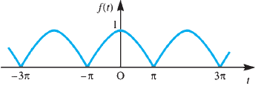
Example:
Find the complex form of the Fourier series expansion of the periodic function $f\left(t\right)$ defined by:
$$f\left(t\right)=\cos\left(\frac{t}{2}\right), \left(−π<t<π\right), f\left(t+2π\right)=f \left(t\right).$$
Solution: For the present case $T=2π$ and $ω=1.$ By using $(2)$ the complex coefficients are given is:
$$c_{0}=\frac{1}{T}\int_{x_{0}}^{x_{0}+T}{f\left(t\right)}dt=\frac{1}{2π}\int_{−π}^{π}{\cos\left(\frac{t}{2}\right)}dt=\frac{2}{π}.$$
$$c_{k}=\frac{1}{T}\int_{x_{0}}^{x_{0}+T}{f\left(t\right)e^{−ikωt}}dt=\frac{1}{2π}\int_{−π}^{π}{\cos\left(\frac{t}{2}\right)e^{−ikt}}dt$$
$$=\frac{1}{2π}\int_{−π}^{π}{\left(\frac{e^{it/2}+e^{−it/2}}{2}\right)e^{−ikt}}dt=\frac{1}{4π}\int_{−π}^{π}{\left[e^{−i\left(k−1/2\right)t}+e^{−i\left(k+1/2\right)t}\right]}dt=\frac{2{(−1)}^{k+1}}{(4k^{2}−1)π}.$$
Note that we can also compute the coefficients $c_{k}$ for $k=1,2,…$ as:
$$c_{k}=\frac{1}{T}\int_{x_{0}}^{x_{0}+T}{f\left(t\right)e^{−ikωt}}dt=\frac{2{(−1)}^{k+1}}{(4k^{2}−1)π} and \overline{c_{k}}=c_{−k}=\frac{1}{T}\int_{x_{0}}^{x_{0}+T}{f\left(t\right)e^{ikωt}}dt=\frac{2{(−1)}^{k+1}}{(4k^{2}−1)π}$$
$$\left(k=±1,±2,…\right)$$

Slide 46
Thus, by using $(1)$ the complex Fourier series expansion for $f(t)$ is given as:
$$f\left(t\right)=\sum_{k=−∞}^{∞}{\frac{2{(−1)}^{k+1}}{(4k^{2}−1)π}e^{ikt}} (∗)$$
Equation $(∗)$ can be converted back to the trigonometric form. By using (7) and observations, we have
$$a_{0}=2c_{0}=2\left(\frac{2}{π}\right)=\frac{4}{π}.$$
Since $f(t)$ is an even function so
$$a_{k}=c_{k}+\overline{c_{k}}=2c_{k}=2\left[\frac{2{(−1)}^{k+1}}{(4k^{2}−1)π}\right].$$
$$b_{k}=0.$$
Thus, by using $(3)$ the trigonometric form of the Fourier series expansion for $f(t)$ is given as:
$$f\left(t\right)=\frac{2}{π}+\frac{4}{π}\sum_{k=1}^{∞}{\frac{{(−1)}^{k+1}}{(4k^{2}−1)}\cos{(kt)}}.$$

Slide 47
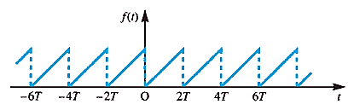
Example:
Obtain the complex form of the Fourier series of the sawtooth function $f(t)$ defined by:
$$f(t) =\frac{2t}{T} (0<t<2T ), f (t+2T)=f(t)$$

Slide 48
Trigonometric Fourier Series (TFS)
For a periodic function $f(x)$ of period $T,$ defined on $x_{0}≤x≤x_{0}+T,$ the Fourier series is defined as:
$$f\left(x\right)=\frac{a_{0}}{2}+ \sum_{k=1}^{∞}{\left[a_{k}\cos\left(kωx\right)+b_{k}\sin\left(kωx\right)\right],} (1)$$
where $a_{0},a_{k}$ and $b_{k}$ are the Fourier coefficients, given by:
$$a_{0}=\frac{2}{T}\int_{x_{0}}^{x_{0}+T}{f\left(x\right)}dx, (2)$$
$$a_{k}=\frac{2}{T}\int_{x_{0}}^{x_{0}+T}{f\left(x\right)\cos\left(kωx\right)dx} \left(k=1,2,3,…\right), (3)$$
and
$$b_{k}=\frac{2}{T}\int_{x_{0}}^{x_{0}+T}{f\left(x\right)\sin\left(kωx\right)dx} \left(k=1,2,3,…\right). (4)$$
which are known as Euler’s formulae.

Slide 49
Complex form of Fourier series (CFS)
The complex form of the Fourier series expansion of a periodic function $f(x)$, of period $T$, is
$$f\left(x\right)=c_{0}+ \sum_{k=1}^{∞}{c_{k}e^{ikωx}+ \sum_{k=1}^{∞}{c_{−k}e^{−ikωx}}}=c_{0}+\sum_{k=1}^{∞}{c_{k}e^{ikωx}}+\sum_{k=−∞}^{−1}{c_{k}e^{ikωx}} (5)$$
where the complex Fourier coefficients are given by:
$$c_{0}=\frac{1}{T}\int_{x_{0}}^{x_{0}+T}{f\left(x\right)}dx, c_{k}=\frac{1}{T}\int_{x_{0}}^{x_{0}+T}{f\left(x\right)e^{−ikωx}}dx and c_{−k}=\frac{1}{T}\int_{x_{0}}^{x_{0}+T}{f\left(x\right)e^{ikωx}}dx \left(k=1, 2,…\right) (6)$$
Alternatively, the complex Fourier series $(1)$ is written as:
$$f\left(x\right)=\sum_{k=−∞}^{∞}{c_{k}e^{ikωx}}; c_{0}e^{0}=c_{0} (7)$$
with
$$c_{0}=\frac{1}{T}\int_{x_{0}}^{x_{0}+T}{f\left(x\right)}dx and c_{k}=\frac{1}{T}\int_{x_{0}}^{x_{0}+T}{f\left(x\right)e^{−ikωx}}dx \left(k=±1,±2,…\right) (8)$$
In general the coefficients $c_{k}$ $\left(n=0, ±1,±2,…\right)$ are complex, and are expressed in the form $c_{k}=\left|c_{k}\right|e^{iφ_{k}},$ $2\left|c_{k}\right|$ is the amplitude of the $k$th harmonic. The argument $φ_{k}$ is related to the phase of the $k$th harmonic.

Slide 50
Connection between TFS & CFS
To develop the complex form of the trigonometric Fourier series we use:
$$sin \left(kωx\right)=\frac{e^{ikωx}−e^{−ikωx}}{2i} and cos \left(kωx\right)=\frac{e^{ikωx}+e^{−ikωx}}{2}$$
The real and complex Fourier coefficients are connected to each other by means of the relations:
$$\frac{a_{0}}{2}=c_{0}, c_{k}=\frac{a_{k}−ib_{k}}{2} and c_{−k}=\overline{c_{k}}=\frac{a_{k}+ib_{k}}{2}, (9)$$
and
$$a_{0}=2c_{0}, a_{k}=c_{k}+\overline{c_{k}} and b_{k}=i\left[c_{k}−\overline{c_{k}}\right], (10)$$
for$k=1,2,…$
Observation:
If the given function $f(x)$ is even we have: $b_{k}=0⇒c_{k}=\overline{c_{k}} and a_{k}=2c_{k}.$
If the given function $f(x)$ is odd we have $a_{0}=a_{k}=0⇒\overline{c_{k}}=−c_{k} and b_{k}=2ic_{k}.$

Slide 51
Amplitude-Phase Form of Fourier series (Compact form)
For a periodic function $f(x)$ of period $T,$ defined on $x_{0}≤x≤x_{0}+T,$ the Fourier series is defined as:
$$f\left(x\right)=\frac{a_{0}}{2}+ \sum_{k=1}^{∞}{\left[a_{k}\cos\left(kωx\right)+b_{k}\sin\left(kωx\right)\right],} (1)$$
where $a_{0},a_{k}$ and $b_{k}$ are the Fourier coefficients. Let
$$\frac{a_{0}}{2}=A_{0}, a_{k}=A_{k}\cos{{(φ}_{k})} and b_{k}=−A_{k}\sin{(φ_{k})}, (11)$$
Using $(11)$ in $(1)$ we get:
$$f\left(x\right)=A_{0}+ \sum_{k=1}^{∞}{\left[A_{k}\cos{{(φ}_{k})}\cos\left(kωx\right)−A_{k}\sin{(φ_{k})}\sin\left(kωx\right)\right]}=A_{0}+ \sum_{k=1}^{∞}{A_{k}\cos\left(kωx+φ_{k}\right),}(12)$$
The term $A_{1}\cos\left(ωx+φ_{1}\right)$ is called the first harmonic or the fundamental mode, and it has the same frequency $ω$ as the parent function $f(x)$. The term $A_{k}\cos\left(kωx+φ_{k}\right)$ is called the $k$th harmonic, and it has frequency $kω,$ which is $k$ times that of the fundamental. The term $A_{k}=\sqrt{{{(a}_{k})}_{}^{2}+{{(b}_{k})}_{}^{2}},$ denotes the amplitude of the $k$th harmonic and $φ_{k}=\arctan\left(\frac{−b_{k}}{a_{k}}\right)$ is the phase angle measuring the lag or lead of the $k$th harmonic with reference to a pure cosine wave of the same frequency.

Slide 52
Alternate Amplitude-Phase Form of Fourier series
For a periodic function $f(x)$ of period $T,$ defined on $x_{0}≤x≤x_{0}+T,$ the Fourier series is defined as:
$$f\left(x\right)=\frac{a_{0}}{2}+ \sum_{k=1}^{∞}{\left[a_{k}\cos\left(kωx\right)+b_{k}\sin\left(kωx\right)\right],} (1)$$
where $a_{0},a_{k}$ and $b_{k}$ are the Fourier coefficients. Let
$$\frac{a_{0}}{2}=A_{0}, a_{k}=A_{k}\sin{{(φ}_{k})} and b_{k}=A_{k}\cos{(φ_{k})}, (13)$$
Using $(11)$ in $(1)$ we get:
$$f\left(x\right)=A_{0}+ \sum_{k=1}^{∞}{\left[A_{k}\sin{{(φ}_{k})}\cos\left(kωx\right)+A_{k}\cos{(φ_{k})}\sin\left(kωx\right)\right]}=A_{0}+ \sum_{k=1}^{∞}{A_{k}\sin\left(kωx+φ_{k}\right),}(14)$$
The term $A_{1}\sin\left(ωx+φ_{1}\right)$ is called the first harmonic or the fundamental mode, and it has the same frequency $ω$ as the parent function $f(x)$. The term $A_{k}\sin\left(kωx+φ_{k}\right)$ is called the $k$th harmonic, and it has frequency $kω,$ which is $k$ times that of the fundamental. The term $A_{k}=\sqrt{{{(a}_{k})}_{}^{2}+{{(b}_{k})}_{}^{2}},$ denotes the amplitude of the $k$th harmonic and $φ_{k}=\arctan\left(\frac{a_{k}}{b_{k}}\right)$ is the phase angle measuring the lag or lead of the $k$th harmonic with reference to a pure sine wave of the same frequency.

Slide 53
Discrete Frequency Spectra
In expressing a periodic function $f(x)$ by its Fourier series expansion, we decompose the function into its harmonic or frequency components.
If $f(x)$ is a periodic function of period $T$ then it has frequency components at frequencies
$$ω_{k}=\frac{2kπ}{T}=kω (k=1,2,3,…)$$
where $ω$ is the frequency, measured in $rad/s$, of the parent function $f(x)$.
A Fourier series may therefore be interpreted as constituting a frequency spectrum of the periodic function $f(x)$, and provides an alternative representation of the function to its time-domain waveform.
This frequency spectrum is often displayed by plotting graphs of both the amplitudes and phases of the various harmonic components against angular frequency $ω_{k}$. A plot of amplitude against angular frequency is called the amplitude spectrum, while that of phase against angular frequency is called the phase spectrum.
For a periodic function $f(x)$, of period $T$, harmonic components only occur at discrete frequencies $ω_{k}$ so that these spectra are referred to as discrete frequency spectra or line spectra.

Slide 54
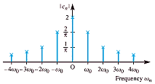
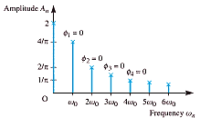
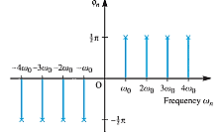
Discrete frequency spectra
With the growing ability to process signals digitally, the representation of signals by their corresponding spectra is an approach widely used in almost all branches of engineering, especially electrical engineering, when considering topics such as filtering and modulation.
An example of the use of a discrete spectral representation of a periodic function is in distortion measurements on amplifiers, where the harmonic content of the output, measured digitally, to a sinusoidal input provides a measure of the distortion.

Slide 55
1-Sided Discrete Frequency Spectra
As seen before, TFS of a periodic function $f(x)$ may be expressed in terms of the various harmonic components by means of equations $(12)$ or $(14)$.
In order to maintain equality of the phases at positive frequencies between the complex and real representations, a cosinusoidal expansion
$$f\left(x\right)=A_{0}+ \sum_{k=1}^{∞}{A_{k}\cos\left(kωx+φ_{k}\right),} (12)$$
of the real Fourier series is frequently adopted.
In this case a plot of $A_{k}=\sqrt{a_{k}^{2}+b_{k}^{2}}$ against angular frequency $ω_{k}$ will constitute the amplitude spectrum and that of $φ_{k}=\arctan\left(\frac{−b_{k}}{a_{k}}\right)$against $ω_{k}$ the phase spectrum. It can be seen that the amplitude spectrum consists of a series of equally spaced vertical lines whose lengths are proportional to the amplitudes of the various harmonic components making up the function $f(x)$.
The discrete spectra obtained in this way is known as 1-sided discrete frequency spectra.

Slide 56
2-Sided Discrete Frequency Spectra
In work on signal analysis it is much more common to use the complex form of the Fourier series.
For a periodic function $f(x)$, of period $T$, this is given by
$$f\left(x\right)=\sum_{k=−∞}^{∞}{c_{k}e^{ikωx}}; c_{0}e^{0}=c_{0} (7)$$
with the complex coefficients being given by:
$c_{k}=\left|c_{k}\right|e^{iφ_{k}}, (k=0,±1,±2,…)$
in which $|c_{k}|$ and $φ_{k}$ denote the magnitude and argument of $c_{k}$ respectively. Since in general $c_{k}$
is a complex quantity, we need two line spectra to determine the discrete frequency spectrum; the
amplitude spectrum being a plot of $|c_{k}|$ against $ω_{k}$ and the phase spectrum that of $φ_{k}$ against $ω_{k}$.
Since $|c_{−k}|=|\overline{c_{k}}|=|c_{k}|,$ the amplitude spectrum will be symmetrical about the vertical axis.
Note that in the complex form of the discrete frequency spectrum we have components at the discrete frequencies $0, ±ω,±2ω,±3ω,…;$ that is, both positive and negative discrete frequencies are involved.
The discrete spectra obtained in this way is known as 2-sided discrete frequency spectra.

Slide 57
The multiplication theorem and Parseval’s theorem
Two useful results, particularly in the application of Fourier series to signal analysis, are the multiplication theorem and Parseval’s theorem.
The multiplication theorem enables us to write down the mean value of the product of two periodic functions over a period in terms of the coefficients of their Fourier series expansions.
Parseval’s theorem enables us to write down the mean square value of a periodic function which determines the power spectrum of the function.
The multiplication theorem
If $f(x)$ and $g(x)$ are two periodic functions having the same period $T$ then:
$$\frac{1}{T}\int_{x_{0}}^{x_{0}+T}{f\left(x\right)g(x)}dx=\sum_{k=−∞}^{∞}{c_{k}\overline{d_{k}}},$$
where the $c_{k}$ and $d_{k}$ are the coefficients in the complex Fourier series expansions of $f(x)$ and $g(x)$ respectively. In terms of the real coefficients $a_{k}$, $b_{k}$ and $α_{k}$, $β_{k}$ of the corresponding trigonometric
Fourier series expansions of $f(x)$ and $g(x)$:
$$\frac{1}{T}\int_{x_{0}}^{x_{0}+T}{f\left(x\right)g(x)}dx=\frac{a_{0}α_{0}}{4}+\sum_{k=1}^{∞}{\left(\frac{a_{k}α_{k}+b_{k}β_{k}}{2}\right).}$$

Slide 58
Parseval’s theorem
If $f(x)$ is a periodic function with period $T$ then:
$$\frac{1}{T}\int_{x_{0}}^{x_{0}+T}{{\left[f(x)\right]}^{2}}dx=\sum_{k=−∞}^{∞}{{\left|c_{k}\right|}^{2}},$$
where the $c_{k}$ are the coefficients in the complex Fourier series expansion of $f\left(x\right).$ In terms of the real coefficients $a_{k}$, $b_{k}$ of the corresponding trigonometric Fourier series expansion of $f(x)$ we have
$$\frac{1}{T}\int_{x_{0}}^{x_{0}+T}{{\left[f(x)\right]}^{2}}dx=\frac{{{(a}_{0})}^{2}}{4}+\sum_{k=1}^{∞}{\left(\frac{{{(a}_{k})}^{2}+{{(b}_{k})}^{2}}{2}\right).}$$
Parseval’s theorem states that the total average power in a periodic signal equals the sum of the average powers in all of its harmonic components.
Note: The root mean square (RMS) value $f_{\text{RMS}}$ of a periodic function $f(x)$ of period $T$ is defined by:
$${f^{2}}_{\text{RMS}}=\frac{1}{T}\int_{x_{0}}^{x_{0}+T}{{\left[f(x)\right]}^{2}}dx.$$
Parseval’s theorem enables us to relate the RMS value of a periodic signal to the complex Fourier coefficients of the frequency domain.

Slide 59
Power Spectrum
The average power $P$ associated with a periodic signal $f(x)$, of period $T$, is defined as the mean square value; that is,
$$P={f^{2}}_{\text{RMS}}=\frac{1}{T}\int_{x_{0}}^{x_{0}+T}{{\left[f(x)\right]}^{2}}dx.$$
For example, if $f(x)$ represents a voltage waveform applied to a resistor then $P$ represents the average power, measured in watts, dissipated by a $1Ω$resistor. By Parseval’s theorem
$$P=\frac{a_{0}^{2}}{4}+\frac{1}{2}\sum_{k=1}^{∞}{\left[a_{k}^{2}+b_{k}^{2}\right].}$$
Thus, the power of the periodic function $f(x)$ is the sum of the power of the individual harmonic components contained in $f(x)$. In terms of the complex Fourier coefficients, Parseval’s theorem gives
$$P=\sum_{k=−∞}^{∞}{{\left|c_{k}\right|}^{2}.}$$
Since the total power of a periodic signal is the sum of the power associated with each of the harmonics of which the signal is composed, it is again useful to consider a spectral representation, and a plot of ${\left|c_{k}\right|}^{2}$against angular frequency $ω_{k}$ is called the power spectrum of the function $f(x)$.

Slide 61

Practice Problems:
A periodic voltage $v(t)$ (in volts) of period $5 ms$ and specified by
$$v\left(t\right)=\left\{\begin{aligned}60, 0<t<1.25 \\ 0, 1.25<t<5 \end{aligned} and v\left(t+5\right)=v\left(t\right) ∀(for all )t. \right.$$
is applied across the terminals of a $15Ω$ resistor.
Obtain expressions for the coefficients $c_{k}$ of the complex Fourier series representation of $v(t)$, and write down the values of the first five non-zero terms.
Calculate the power associated with each of the first five non-zero terms of the Fourier expansion.
Calculate the total power delivered to the $15Ω$ resistor.
What is the percentage of the total power delivered to the resistor by the first five non-zero terms of the Fourier series?

Slide 68
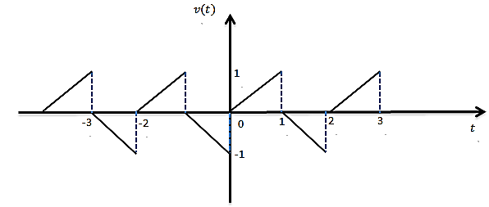
Filtering
In a variety of applications, it is of interest to change the relative amplitudes of the frequency
components in a signal or perhaps eliminate some frequency components entirely, a process referred to as filtering.
Example:
Identify the period and frequency in both hertz and radians/sec of the periodic voltage shown in figure.
Moreover, calculate the complex Fourier coefficients. The signal is passed through a band pass filter that passes only frequencies from 2.25 to 2.75 KHz. What signal emerges expressed as sines and cosines?

Slide 69
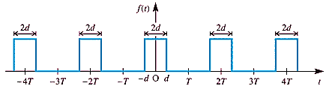

Practice Problems:
Plot the one sided and two sided discrete amplitude and phase spectra for the periodic function
$$f\left(x\right)=\frac{2x}{T} \left(0<x<2T \right), f\left(x+2T\right)=f\left(x\right).$$
Determine the complex form of the Fourier series expansion of the periodic (period $2T$) infinite train of identical rectangular pulses of magnitude $A$ and duration $2d$ illustrated in figure. Draw the discrete frequency spectrum in the particular case when $d=\frac{1}{10}$ and $T=\frac{1}{2}$ .
Let $v\left(t\right)=\sin\left(4πt\right)$ be the input signal to the circuit shown in figure. Using Parseval’s theorem, determine the average power delivered to the resistor $R=5Ω$.
Infinite train of rectangular pulses

Slide 70
Practice Problems:
Identify the period and frequency of the periodic voltage
$$v\left(t\right)=\left\{\begin{aligned}t, −1<t<0 \\ 1−t, 0<t<1 \end{aligned}and v\left(t+2\right)=v\left(t\right) ∀t. \right.$$
The complex Fourier coefficients for $v(t)$ are given by:
$$c_{k}=\frac{1}{2}\left[\frac{1}{n^{2}π^{2}}−\frac{i}{nπ}−\frac{1}{n^{2}π^{2}}e^{−inπ}+\frac{i}{nπ}e^{inπ}+\frac{i}{n^{2}π^{2}}−\frac{1}{n^{2}π^{2}}e^{inπ}\right]$$
The signal is passed through a band pass filter that passes only frequencies from 3.25 to 3.75 KHz.
What signal emerges expressed as sines and cosines?
A periodic voltage $v(t)$ (in volts) of period $5 ms$ and specified by
$$v\left(t\right)=\left\{\begin{aligned}60, 0<t<1.25 \\ 0, 1.25<t<5 \end{aligned} and v\left(t+5\right)=v\left(t\right) ∀t. \right.$$
is applied across the terminals of a $15Ω$ resistor.
Obtain expressions for the coefficients $c_{k}$ of the complex Fourier series representation of $v(t)$, and write down the values of the first five non-zero terms.
Calculate the power associated with each of the first five non-zero terms of the Fourier expansion.
Calculate the total power delivered to the $15Ω$ resistor.
What is the percentage of the total power delivered to the resistor by the first five non-zero terms of the Fourier series?

